Slide 1
Prevention of Sexual Exploitation and Abuse

Slide 2
Welcome to the United Nations course on “Prevention of Sexual Exploitation and Abuse by UN Personnel”.
This mandatory course is for all UN personnel, whether at Headquarters or at another duty station.
The course contains videos, scenarios and examples describing cases of sexual exploitation and abuse by UN personnel. These are fictitious examples based on facts from real-life cases. Names of victims, perpetrators and locations as well as voices have been changed to protect identities.
If you have managerial or command responsibilities, please find your version of your course below, entitled "Prevention of Sexual Exploitation and Abuse by UN Personnel (for managers and commanders)”.

Slide 3
Introduction
Overall objectives
Lesson 1: UN standards
What are the UN standards of conduct on sexual exploitation and abuse by UN personnel?
Lesson 2: Consequences for abusers
What are the consequences of breaching UN standards of conduct on sexual exploitation and abuse?
Lesson 3: Obligations of UN personnel
What are the obligations of all UN personnel to uphold UN standards of conduct on sexual exploitation and abuse, and how should you report sexual exploitation and abuse by UN personnel?
Lesson 4: Managerial and command responsibilities
What are the specific responsibilities of managers and commanders in addressing sexual exploitation and abuse, what actions can they take to prevent such abuses and how should they handle allegations involving subordinates?

Slide 4

Video
Notes:
https://player.vimeo.com/video/691863480

Slide 5
LESSON 1. UN STANDARDS
Hi and welcome on board! I’m Hiroko. I am a UN trainer. I will accompany you through this course.
In this lesson, you will learn about:
Who is required to follow the UN standards of conduct on sexual exploitation and abuse?
What is prohibited conduct?
What is strongly discouraged conduct?
What are some misconceptions that UN personnel might have about sexual exploitation and abuse?

Slide 6
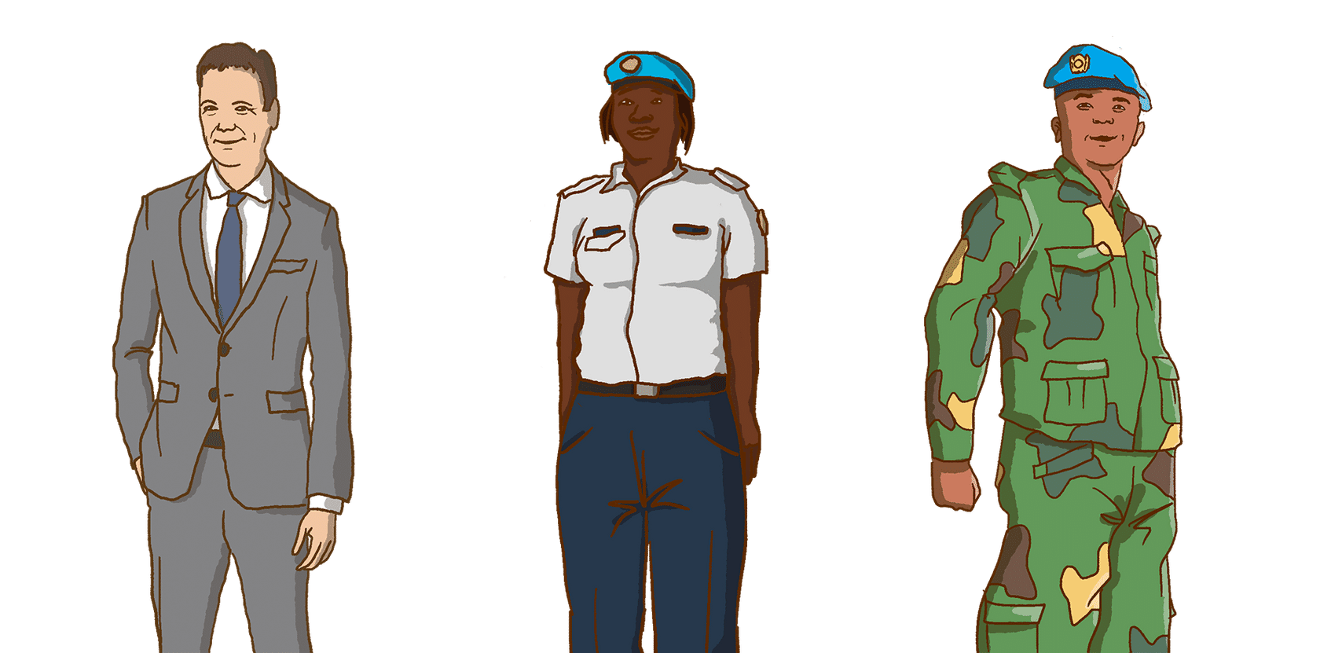
Meet the team
Hi! I’m Peter – nice to meet you.
I am an expert on the UN standards of conduct and hope to be able to answer your questions.
Hi! I’m Fatou. This is my fourth deployment with the UN now and I understand the challenges of living and working in the field.
Hello! I’m Malik. This is my first deployment with the UN so everything about the UN is new to me.

Slide 7
UN standards of conduct on sexual exploitation and abuse
Do you have to follow the UN standards of conduct on sexual exploitation and abuse?
Notes:
https://player.vimeo.com/video/697422325?h=1c0ac0d11e

Slide 8
Full listing of who is required to follow the UN standards of conduct
Here you can see a full listing of who is required to follow the UN standards of conduct on sexual exploitation and abuse:
All UN civilian personnel
All UN civilian personnel including:
All internationally recruited and locally recruited UN staff, including staff of Departments and Offices of the UN Secretariat and its field presences (e.g. UN missions), UN Offices Away from Headquarters and UN Regional Commissions, UN Agencies, Funds and Programmes and UN Specialized Agencies.
UN Volunteers (UNV).
Civilian experts on mission, including military observers, military deployed officers, correction judicial officers as well as other government provided personnel.
Personnel or employees of non‐UN entities or individuals that have entered into a cooperative arrangement with the UN, including interns, Junior Professional Officers (JPO), international and local consultants, and corporate and individual contractors, including day labourers.

Slide 9
Full listing of who is required to follow the UN standards of conduct
All UN uniformed personnel
All UN uniformed personnel including:
Members of national military contingents.
Members of national formed police units (FPU).
UN personnel with the legal status of experts on mission, which includes UN police officers (UNPOL), corrections officers, military observers (UNMO) and military liaison officers.

Slide 10
What conduct is prohibited ?
As you can see, the UN standards of conduct prohibit certain behaviour.
No sexual activity with a child (a person under the age of 18).
No sex with prostitutes.
No exchange of money, food, employment, goods, assistance or services for sex or sexual favours.
No use of a child or an adult to procure sex for others.

Slide 11
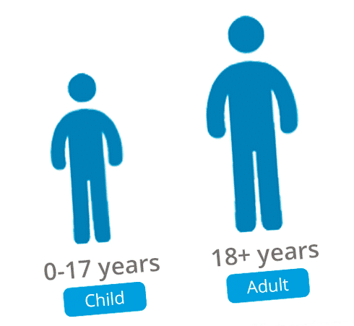
No sexual activity with a child
The UN prohibits sexual activity with a child.
A child is a person under the age of 18.
Even if you are in a country where the age of majority or the age of consent is lower than 18, you are still required to follow the stricter UN standards of conduct that prohibit sexual activity with anyone under the age of 18.
Please note: The age of majority means the age at which a person is legally considered an adult. The age of consent means the age at which a person is considered legally competent to consent to sexual relations.

Slide 12
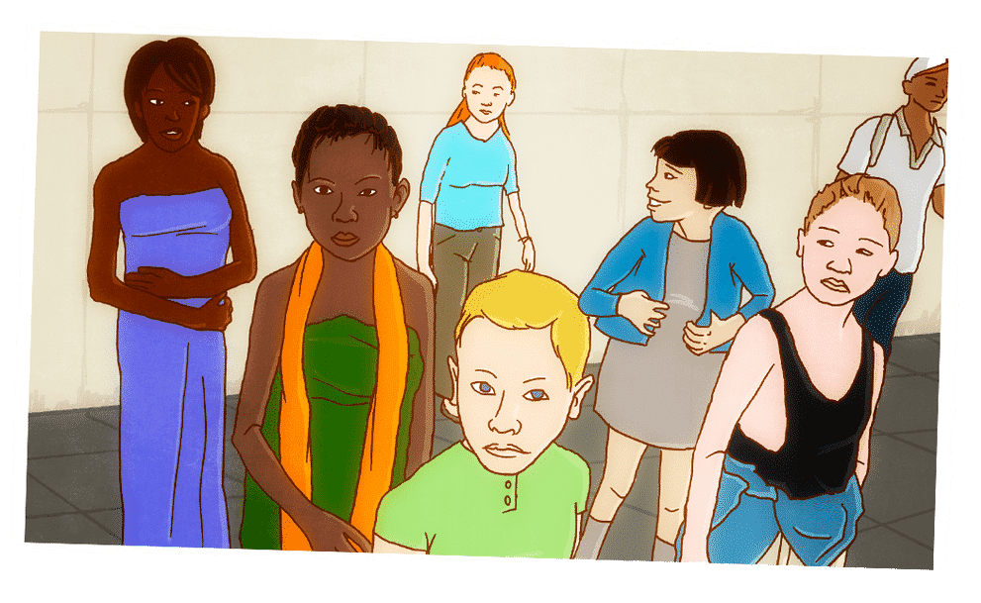
No sexual activity with a child
Mistaken belief in the age of a child is not a valid defense in a case of sexual exploitation and abuse.
If a child lies about their age and tells you they are over 18 when they are not, the UN will still consider you to be at fault.

Slide 13

No sex with prostitutes.
The UN also prohibits sex with prostitutes.
No sex with prostitutes, even if prostitution is tolerated or legal in the country.
In some countries, prostitution is tolerated and in other countries, it is legal. But as long as you work or serve in the UN, you have to abide by the stricter UN standards of conduct that prohibit sex with prostitutes.

Slide 14
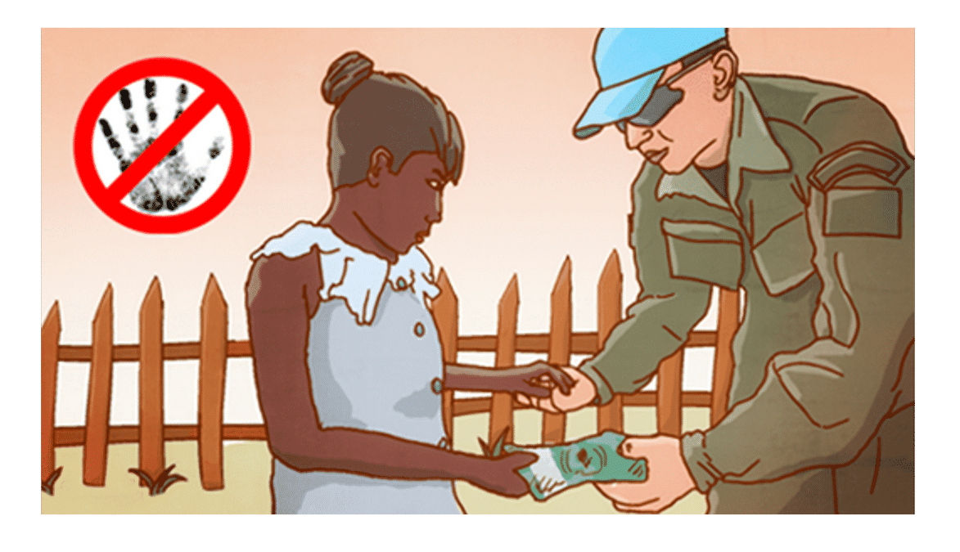
No sex in exchange for money/goods
The UN also prohibits sex in exchange for money and goods.
No exchange of money, food, employment, goods, assistance, or services for sex or sexual favours.
For example, giving someone gifts, a new job, food aid rations, or helping them pay for family expenses in exchange for sex is prohibited.

Slide 15
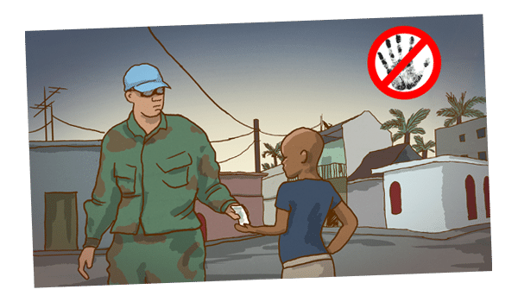
No use of any child/adult to procure sex for others
The UN also prohibits the use of a child or adult to procure sex for others.
In the past, there have been cases around UN military camps where soldiers have used children to bring them local women to have sex in exchange for money. This is prohibited.

Slide 16

What conduct is prohibited by the UN?
You now know what behaviour is prohibited by UN standards of conduct. This should help you identify what is prohibited conduct in the following situations that UN personnel may encounter.
Read the three scenarios and answer the questions that follow them.

Slide 17

Scenario 1
Chantalle is a 25-year old woman who recently moved to town because of fighting between the government and rebels in her home area. Her family lost everything when they fled and she has been forced to sell sex to survive.
John is a civilian who works in the UN. One Saturday night, he meets Chantalle in a bar. John takes Chantalle home and pays her for sex. As paying for sex is tolerated in this country, John believes he is doing nothing wrong.

Slide 18
Has John committed sexual exploitation and abuse?
Yes.
No

Slide 19
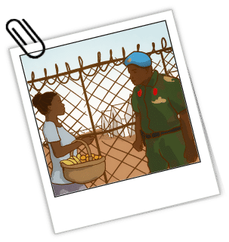
Scenario 2
Joyce regularly comes to the UN military base to sell fruit and vegetables to the UN soldiers. After paying for food, Joyce rarely has any money left over for luxuries at the end of the month. Aki is a soldier at the UN military base. They chat regularly and get to know each other. Eventually she becomes his girlfriend and they start a sexual relationship. Every time they meet to have sex, Aki gives Joyce small gifts of jewellery and mobile phone credits. Joyce lied about her age and told Aki she was 20 years old. However, Joyce is only 16 years old.

Slide 20
Has Aki committed sexual exploitation and abuse?
Yes.
No.
Can Aki claim in his defence that he made a mistake about Joyce’s age and mistakenly believed her to be over 18 years of age?
Yes.
No.

Slide 21
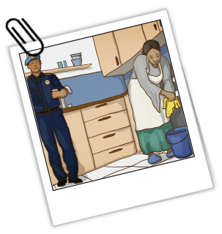
Scenario 3
Mateo is a UN Police Officer. He has moved into a house in town and hired Samira as a housekeeper. Samira cleans the house and stays on in the evenings to cook Mateo’s meals. Many times, Mateo invites Samira to eat with him and chat. Samira’s husband was killed in the war and her two teenage children are at school in another town. Samira sometimes feels lonely and she always looks forward to talking to Mateo.
One evening, Mateo returns home drunk just as Samira is getting ready to leave. Mateo asks Samira to stay the night, pointing to his bedroom. Samira is shocked and looks embarrassed. Mateo then reminds her that good jobs are hard to find these days. Samira is scared of losing her job. Without this job, her children will have to drop out of school. Samira stays the night and has sex with Mateo.

Slide 22
Has Mateo committed sexual exploitation and abuse?
Yes
No

Slide 23
Difference between sexual exploitation and sexual abuse
Definitions
“Sexual exploitation” means any actual or attempted abuse of a position of vulnerability, differential power, or trust, for sexual purposes, including, but not limited to, profiting monetarily, socially or politically from the sexual exploitation of another.
“Sexual abuse“ means the actual or threatened physical intrusion of a sexual nature, whether by force or under unequal or coercive conditions.

Slide 24
Difference between sexual exploitation and sexual abuse
Recent UN measures
In his 2014 report on special measures for protection from sexual exploitation and sexual abuse, the UN Secretary-General introduced a programme of action with more than 40 proposals on prevention, enforcement and remedial action to strengthen the UN zero tolerance policy on sexual exploitation and abuse (A/69/779).
In his 2015 report, additional measures were also proposed (A/70/729).
On 11 March 2016, the Security Council adopted resolution 2272 on sexual exploitation and abuse in UN peacekeeping operations. The Security Council requests specific actions on a range of issues, including strengthening the accountability of troop- and police-contributing countries (S/RES/2272).
In his 2016 report, the Secretary-General presented a new approach based on four tracks: first, to put the rights and dignity of victims first; second, to focus on ending impunity for those guilty of crimes and abuses; third, to draw on the wisdom and guidance of all those who have been affected, civil society, local communities and others to strengthen and improve our efforts; fourth and finally, to raise awareness and share best practices (A/71/818).
In February 2016, the Secretary-General appointed a Special Coordinator on improving the United Nations response to sexual exploitation and abuse. The Special Coordinator´s role is to work across the United Nations system’s offices, departments and agencies to strengthen the UN response to sexual exploitation and abuse, from headquarters to the most remote field locations.
In 2017, the Secretary-General appointed a system-wide Victims’ Rights Advocate (VRA) at UN Headquarters so that the United Nations system can work as a whole to provide tangible and sustained assistance to the victims of sexual exploitation and abuse.
Other system wide resources on sexual exploitation and abuse include the IASC website.

Slide 25
Difference between sexual exploitation and sexual abuse
Full text of the UN standards of conduct
Victims Assistance Protocol

Slide 26
Quiz
Decide which types of behaviour constitute sexual exploitation and abuse.
Taking sexually explicit photos of a person under the age of 18.
Offering a job in exchange for sexual acts.
Asking for sex in exchange for offering safe passage through dangerous areas.
Paying for sex with a prostitute in a country where prostitution is legal.
Engaging in any type of sexual activity with a person under 18 years of age.
Paying for school fees in exchange for sexual acts.
Paying for sexual acts in a massage parlour.
Asking someone to find you a person to have sex with in exchange for money.
Soliciting sex, even if no sexual act follows.
Providing assistance or aid of any kind, including food, clothing and lodging, in exchange for sexual favours.
Forcing a young boy to engage in sexual acts.
Helping someone to get a visa to another country in exchange for sexual favours.
Allowing your UN colleague to use your room to have sex with someone in exchange for money.
Threatening to withhold assistance or aid of any kind in exchange for sexual favours.
Unwanted sexual touching of a beneficiary of humanitarian assistance.

Slide 27
Quiz
All these types of behaviour constitute sexual exploitation and abuse and are prohibited by the UN.
Taking sexually explicit photos of a person under the age of 18.
Offering a job in exchange for sexual acts.
Asking for sex in exchange for offering safe passage through dangerous areas.
Paying for sex with a prostitute in a country where prostitution is legal.
Engaging in any type of sexual activity with a person under 18 years of age.
Paying for school fees in exchange for sexual acts.
Asking someone to find you a person to have sex with in exchange for money.
Paying for sexual acts in a massage parlour.
Soliciting sex, even if no sexual act follows.
Providing assistance or aid of any kind, including food, clothing and lodging, in exchange for sexual favours.
Forcing a young boy to engage in sexual acts.
Helping someone to get a visa to another country in exchange for sexual favours.
Allowing your UN colleague to use your room to have sex with someone in exchange for money.
Threatening to withhold assistance or aid of any kind in exchange for sexual favours.
Unwanted sexual touching of a beneficiary of humanitarian assistance.

Slide 28
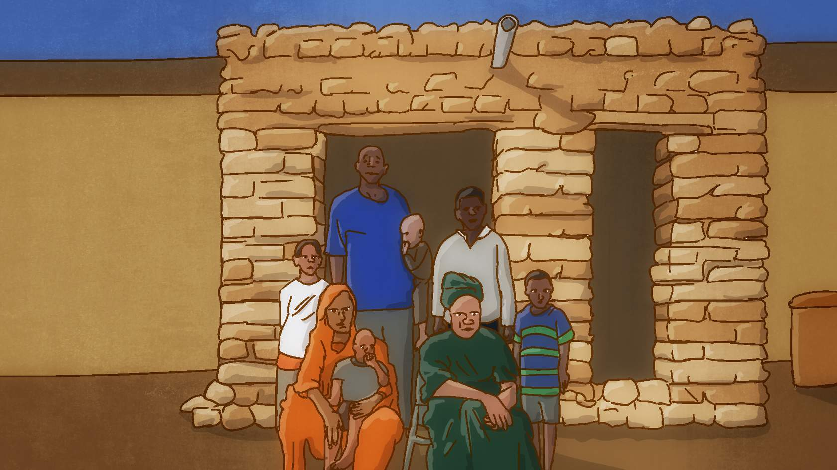
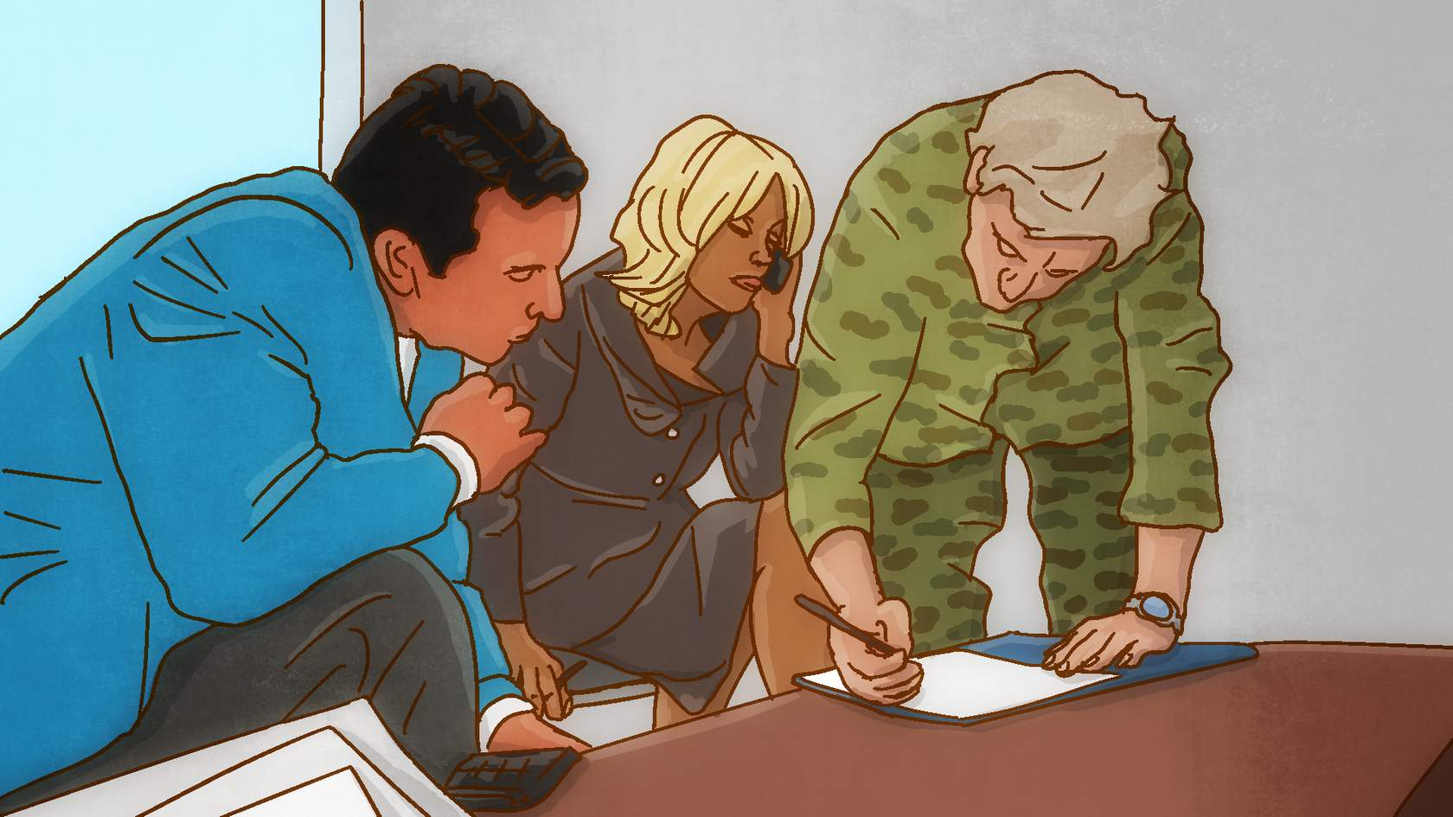
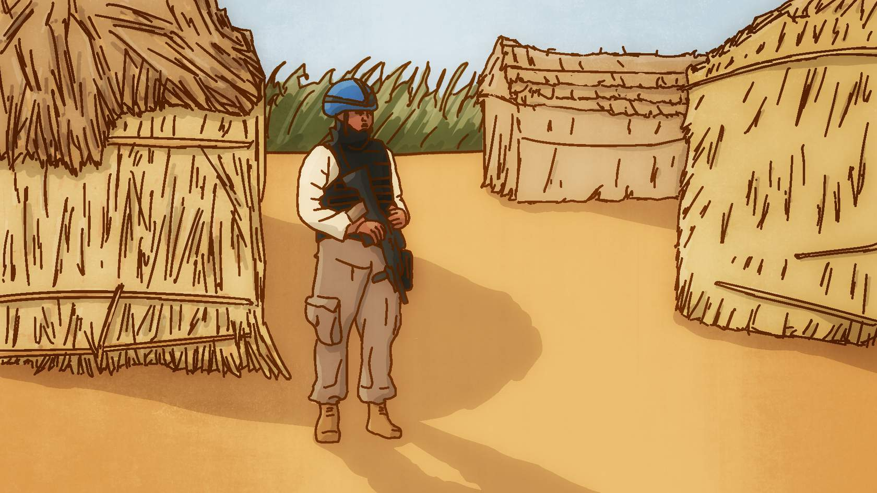
What conduct is strongly discouraged by the UN?
In many countries, unemployment is very high and families are struggling to survive.
UN personnel have money in their pockets and hold positions of authority.
This gives UN personnel power over vulnerable people in the community. UN personnel must not take advantage and abuse this power.

Slide 29
What conduct is strongly discouraged by the UN?
The UN is there to protect the local population. The UN strongly discourages sexual relationships between UN personnel and beneficiaries of assistance. Can you explain why?

Slide 30
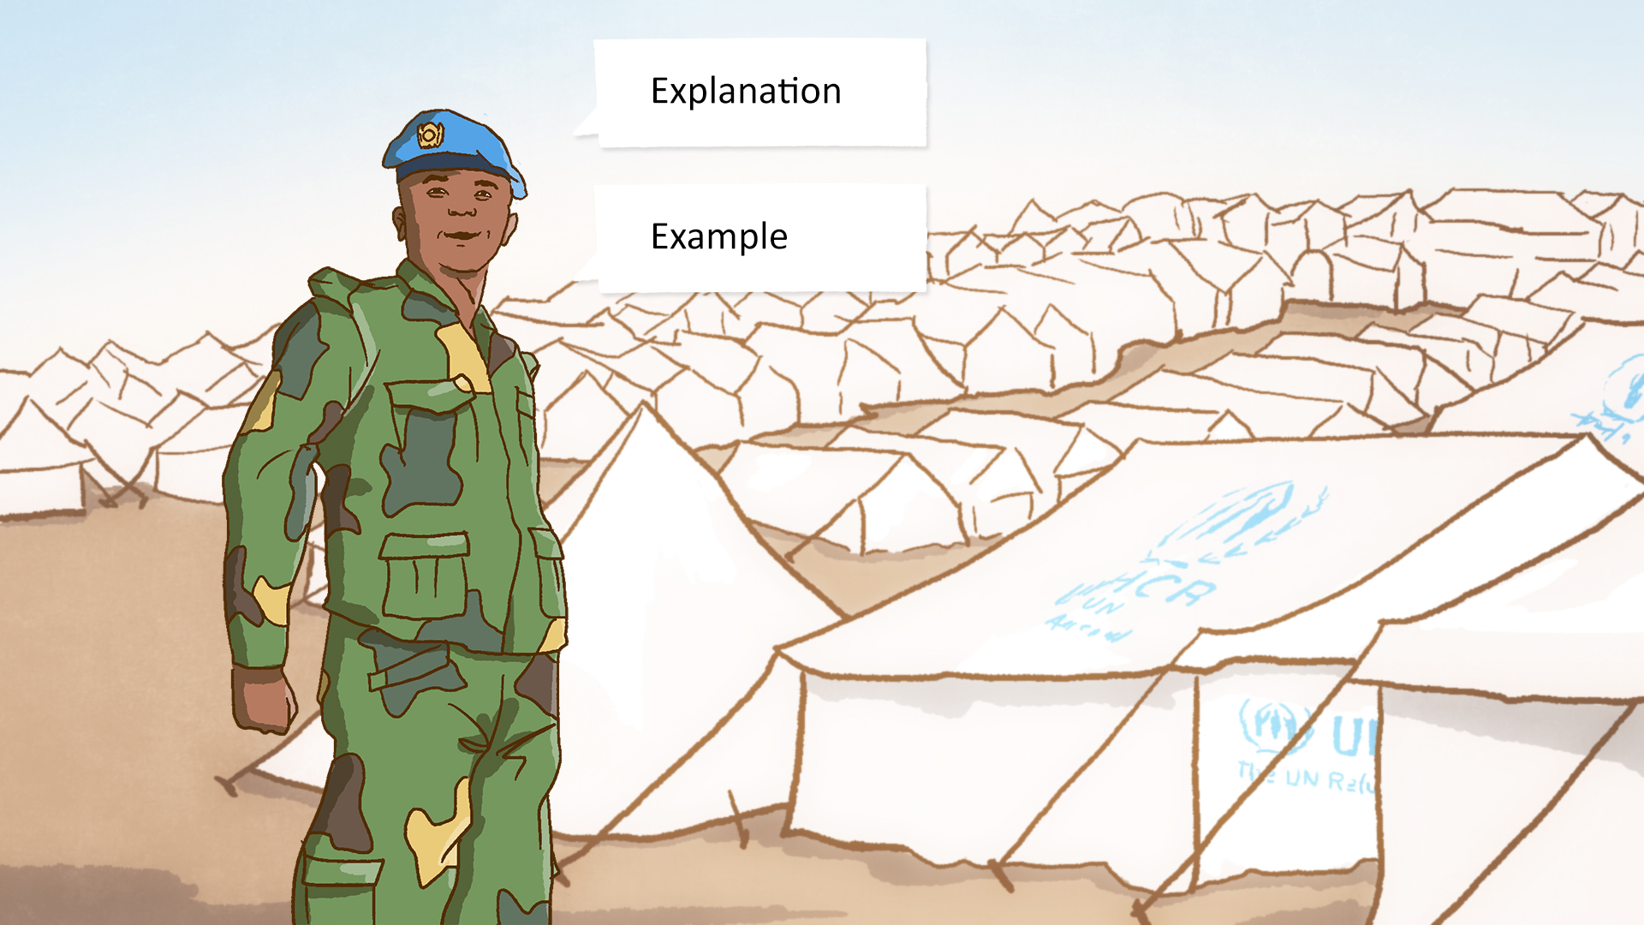
What conduct is strongly discouraged by the UN?
Explanation
Yes, it is because of the inherent power imbalance between UN personnel and beneficiaries of assistance. That is why the UN strongly discourages sexual relationships between them.
Example
A sexual relationship between a UN staff member and a refugee living in a camp is strongly discouraged because of the inherent power imbalance.

Slide 31
What conduct is strongly discouraged by the UN?
Sexual relationships with members of the community could also put the safety of UN personnel at risk.

Slide 32
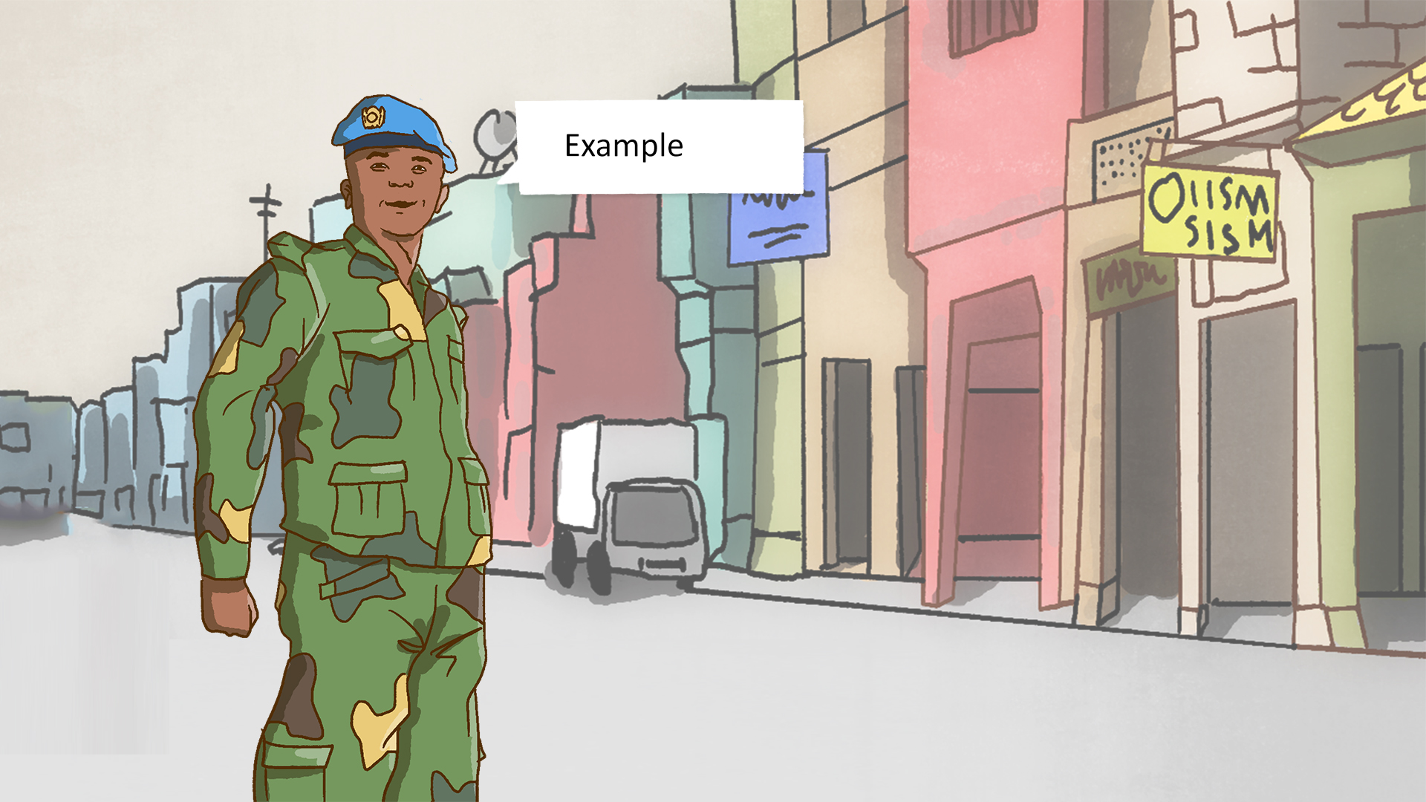
What conduct is strongly discouraged by the UN?
Example
There have been incidents where UN personnel have been attacked by upset family members, blackmailed or falsely accused of sexual exploitation and abuse, after ending a sexual relationship with a girlfriend from the local community.

Slide 33
What conduct is strongly discouraged by the UN?
If you are unsure whether it violates UN standards of conduct or not… don’t do it.

Slide 34

Summary
What you have covered in lesson 1:
The UN standards of conduct apply to all UN personnel and must be followed at all times.
No sexual activity with a child (a person under the age of 18).
No sex with prostitutes.
No exchange of money, food, employment, goods, assistance or services for sex or sexual favours.
No use of any child or adult to procure sex for others.
The UN strongly discourages sexual relationships between UN personnel and beneficiaries of assistance because of the inherent power imbalance. If you are unsure…don’t do it.

Slide 35
LESSON 2. CONSEQUENCES FOR ABUSERS
What will you learn in lesson 2?
Welcome to lesson 2: Consequences for abusers
In this lesson, you will learn about:
What is the impact of sexual exploitation and abuse on victims?
What are the consequences for UN personnel who commit sexual exploitation and abuse?
How does sexual exploitation and abuse damage the work of the UN?

Slide 36
What is the impact of sexual exploitation and abuse on victims?
Sexual exploitation and abuse harms victims’ minds and bodies and violates their dignity.

Slide 37
What is the impact of sexual exploitation and abuse on victims?
Can you tell me more about the ways in which sexual exploitation and abuse impacts its victims?

Slide 38
What is the impact of sexual exploitation and abuse on victims?
Malik
Sexual exploitation and abuse harms victims physically.
Physical harm:
Bruising and injuries, problems with the reproductive system, unwanted pregnancy, sexual dysfunction, contracting HIV or other sexually transmitted infections.

Slide 39
What is the impact of sexual exploitation and abuse on victims?
Fatou
It also harms victims emotionally and psychologically.
Emotional and psychological harm:
Feelings of shame and guilt, poor self-esteem, anxiety, depression, eating and sleeping disorders, suicidal behaviour and self-harm, alcohol and drug abuse, unsafe sexual behaviour, post-traumatic stress disorder (PTSD).

Slide 40
What is the impact of sexual exploitation and abuse on victims?
Peter
And it harms victims socially.
Social harm:
In many countries, there are strict social norms about how women, men, girls and boys are expected to behave. When sexual exploitation and abuse occurs, families and communities may punish victims for having violated these social norms. Victims may be beaten by their families, be forced to leave home, or lose their families’ financial support. Victims may be ostracized by their communities. In some countries, victims may be arrested by the police, for instance, for sex outside of marriage.

Slide 41
What happens to a child born as a result of sexual exploitation and abuse?
When we talk about the impact on victims, what happens to a child born as a result of sexual exploitation and abuse?

Slide 42
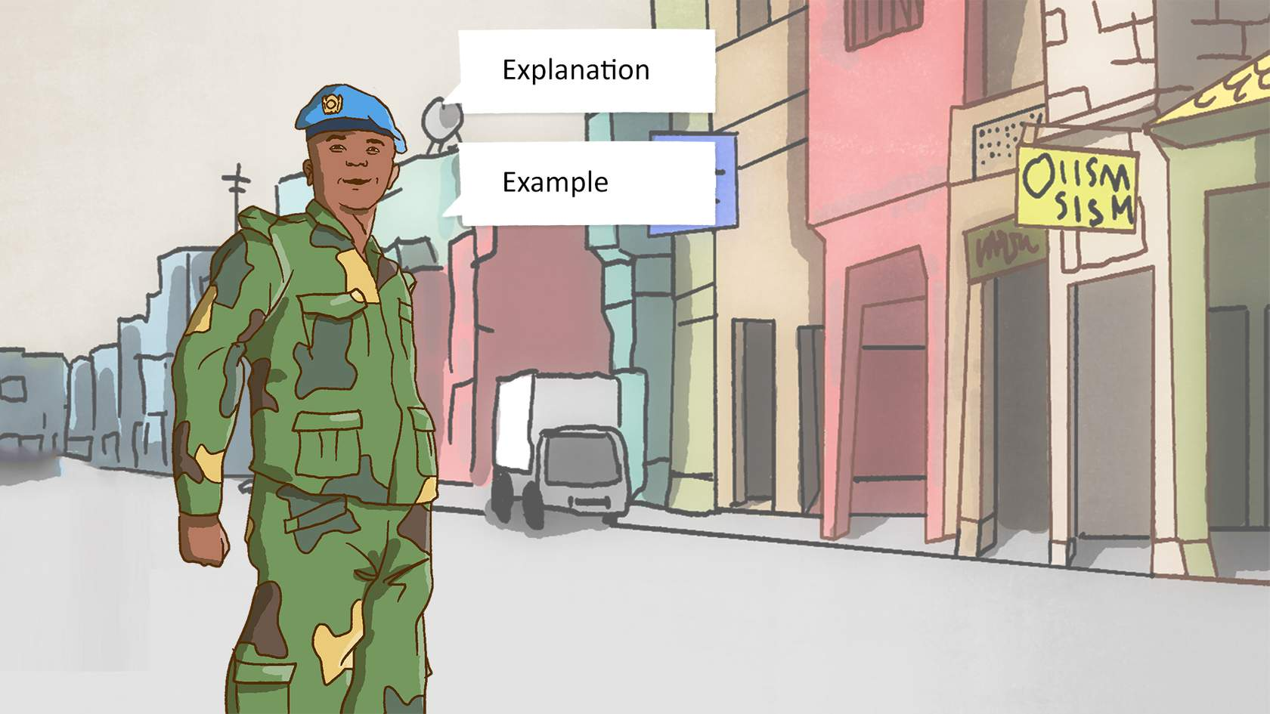
What happens to a child born as a result of sexual exploitation and abuse?
Explanation
A child born as a result of sexual exploitation and abuse by UN personnel may face life-long disadvantage and discrimination.
Example
In the Democratic Republic of the Congo, a non-governmental organization (NGO) reported that a child born to a Congolese mother who had been sexually exploited by a UN peacekeeper was growing up in extreme poverty.
A child growing up in extreme poverty is more likely to be malnourished, not go to school and die early from preventable diseases. A child born out of SEA is also likely to experience discrimination and a sense of shame.

Slide 43
Jane's story
Let us listen to this video where Jane explains how a UN personnel sexually exploited and abused her, and how this impacted her life.

Slide 44
Jane's story
Notes:
https://player.vimeo.com/video/697422985

Slide 45
What are the consequences for UN personnel who commit sexual exploitation and abuse?
Four main consequences
There are four main consequences for UN personnel who commit sexual exploitation and abuse:
Their professional life will suffer.
They may be prosecuted.
Their safety and health may be at risk.
Their personal life will suffer.

Slide 46
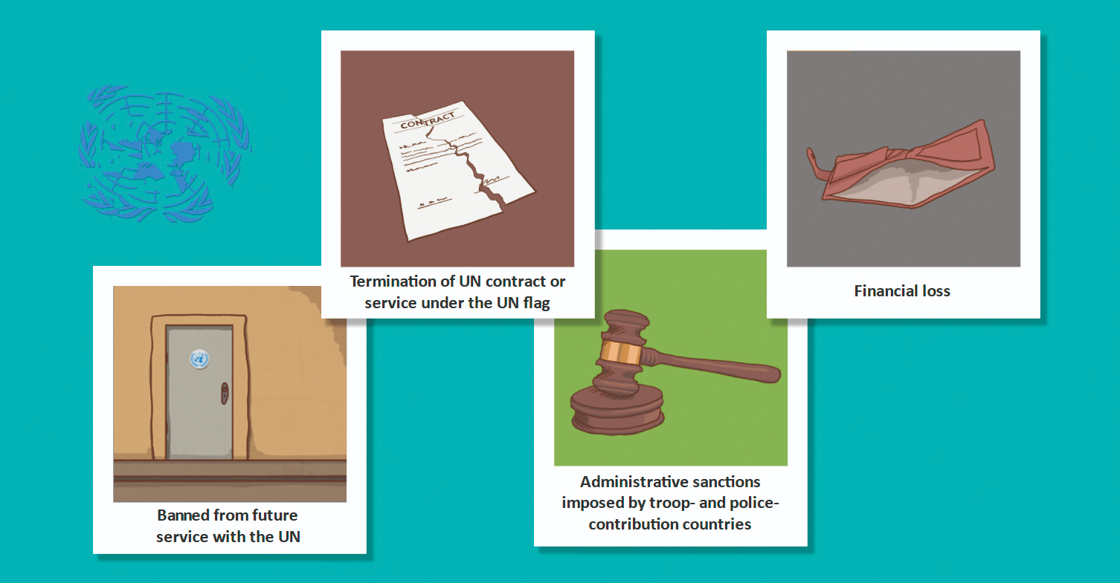
Consequences: Their professional life will suffer

Slide 47

Consequences: Their professional life will suffer
Termination of UN contract or service under the UN flag
Sexual exploitation and abuse are acts of serious misconduct. If an allegation of sexual exploitation and abuse is proven to be true, UN personnel will no longer be allowed to work for the UN or serve under the UN flag.
UN civilians will be dismissed from their jobs. Cooperative agreements with NGOs, private sector contractors, consultants and interns can be terminated. Uniformed personnel will be repatriated by the UN to face justice in their home country. If there is credible evidence of widespread or systematic sexual exploitation and abuse, the UN may repatriate an entire military unit or formed police unit.

Slide 48

Consequences: Their professional life will suffer
Financial loss
The UN can impose a fine on UN staff and withhold payments for those who have been dismissed for sexual exploitation and abuse. The UN can also withhold payment to troop- and police-contributing countries from which uniformed personnel are found guilty of sexual exploitation and abuse.

Slide 49
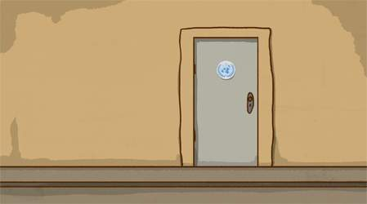
Consequences: Their professional life will suffer
Banned from future service with the UN
If a person has engaged in sexual exploitation and abuse, they will be banned from all future service with the UN. They can never work for the UN again.
The UN has in place a mechanism that ensures that prior offenders are not rehired or redeployed with the UN, including employment within the UN system.

Slide 50

Consequences: Their professional life will suffer
Administrative sanctions imposed by troop- and police-contributing countries
Troop- and police-contributing countries may also impose their own administrative sanctions such as removal from a position of command and removal of benefits.

Slide 51
Consequences: UN personnel may be prosecuted
UN personnel have privileges and immunities to enable them to perform their work-related functions. These privileges and immunities can never be used to shield UN personnel from prosecution for sexual exploitation and abuse or any other crimes they may have committed. If a crime such as rape has been committed, UN personnel can be prosecuted.
Let us see how UN personnel are prosecuted for crimes.

Slide 52
Consequences: UN personnel may be prosecuted
The UN Secretary-General can waive the immunity of UN personnel to allow them to face a criminal prosecution, and has done so in the past.
Uniformed personnel who engage in sexual exploitation and abuse are repatriated by the UN, and typically face a court martial or other disciplinary proceedings instituted by their national authorities. These could lead to dismissal and imprisonment.

Slide 53

Consequences: UN personnel may be prosecuted for child support
UN personnel must honour their private legal obligations, which includes any court orders requiring them to pay for child support. This means that UN personnel are liable for child support if a child is born as a result of them engaging in sexual exploitation and abuse.

Slide 54

Consequences: UN personnel may be prosecuted for child support
In a child support claim, paternity must be established. Can you explain what role the UN plays in paternity claims?

Slide 55
Consequences: UN personnel may be prosecuted for child support
The UN can help collect DNA from UN personnel in paternity claims, with the alleged father’s consent.

Slide 56
Consequences: UN personnel may be prosecuted for child support
And what happens once paternity has been established?

Slide 57
Consequences: UN personnel may be prosecuted for child support
If a court order is received, the UN will deduct child support from staff salaries. If a court order is made against uniformed personnel, the UN will transmit it to the relevant troop- or police-contributing country for action.

Slide 58
What do you think?
Sexual exploitation and abuse may also put the safety and health of UN personnel and others at risk. What are some specific risks?
There is a risk of retaliation and physical attacks against UN personnel who commit sexual exploitation and abuse.
There is a risk of retaliation and physical attacks against the colleagues and fellow contingent members of UN personnel who commit sexual exploitation and abuse.
There is a risk of UN personnel contracting and transmitting HIV and other sexually transmitted infections.

Slide 59
Consequences: Their personal life will suffer
UN personnel who commit sexual exploitation and abuse will see their personal and professional reputation ruined. They may be ostracized by their peers and/or community, and their relationships with family and friends may break down.
Let us now hear what happened to three UN personnel who committed sexual exploitation and abuse.

Slide 60
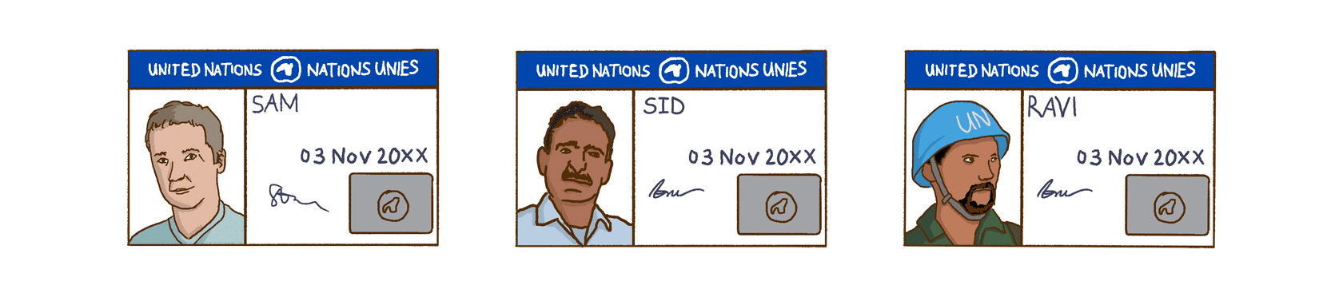
Abusers speak out
Sam
The UN fired me for paying for sex with a local. She looked a lot older, but she was only 15. The last days in the office were like hell. I used to joke with my colleagues all the time. But suddenly everyone avoided me.
Now I am back at home. The UN fined me, so I don’t have much money to live on. My professional reputation is in ruins. No-one will hire me.
Last week, a police car came around to the house. It was the middle of the day, so all the neighbours could see. The police officers took my passport. They said I will be prosecuted for having sex with a child while overseas. This is a crime in my country.

Slide 61
Abusers speak out
Sid
I was repatriated by the UN to my home country. When the investigation found me guilty of sexual exploitation and abuse, I was dismissed from the police service. After 20 years of service in the police, no-one will remember me for my good work. They will only remember me as that man who sexually exploits women.
When my wife found out what I had done, she went to live with her parents and took the children with her. Now she says she wants a divorce. She says that the shame of divorce is better than the shame of living with me.

Slide 62
Abusers speak out
Ravi
I was repatriated by the UN to my home country. A court martial found me guilty of serious misconduct for having engaged in sexual exploitation and abuse while serving under the UN flag overseas. I was given a dishonourable discharge. I lost all my benefits and I was imprisoned.
After serving my sentence, I met some soldiers from my former platoon. They say that I have embarrassed my country and brought dishonour to my regiment.

Slide 63
Abusers speak out
These three stories of sexual exploitation and abuse by UN personnel are fictitious examples based on facts from real-life cases. Names of perpetrators and voices have been changed to protect identities.

Slide 64
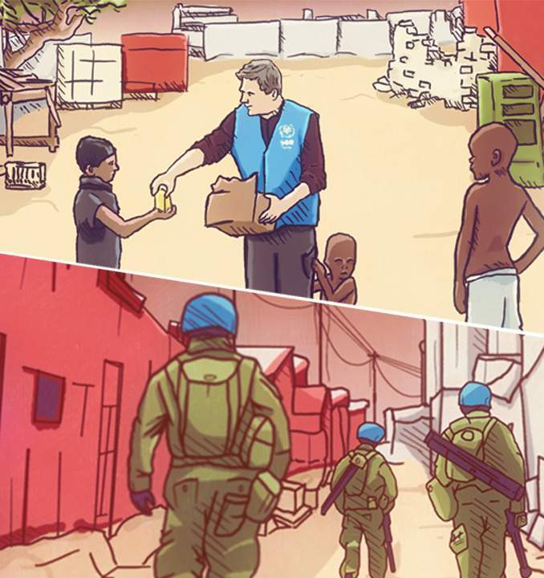
Sexual exploitation and abuse damages the work of the UN
Acts of sexual exploitation and abuse damage the image and credibility of the UN. This in turn undermines the ability of the UN to implement its mandate and do its work effectively.

Slide 65
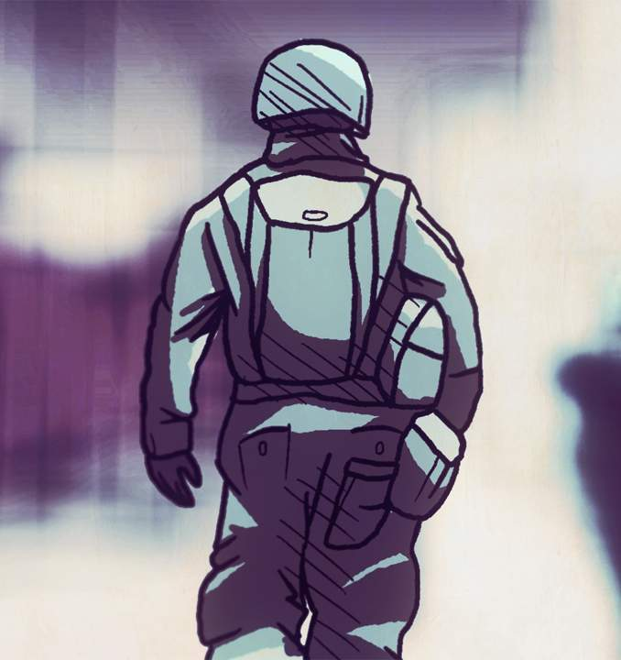
Sexual exploitation and abuse damages the work of the UN
For example, allegations of sexual exploitation and abuse by UN personnel have overshadowed the important work that the UN is doing to bring peace and security, and diverted management time and resources away from mandate implementation. In countries where the UN has a mandate to protect civilians, acts of sexual exploitation and abuse directly undermine this mandate.

Slide 66
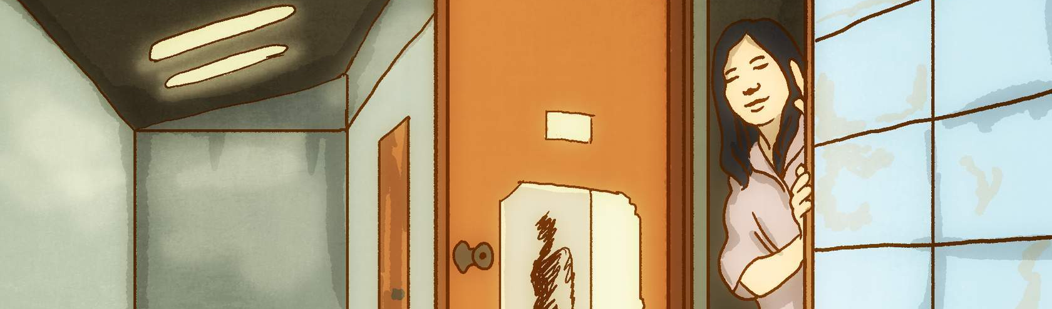
Sexual exploitation and abuse damages the work of the UN
In some countries, women have been trafficked and forced to work in the commercial sex industry. When UN personnel buy sex, this may fuel human trafficking and undermine the work of the UN and others in combating serious and organized crime.

Slide 67
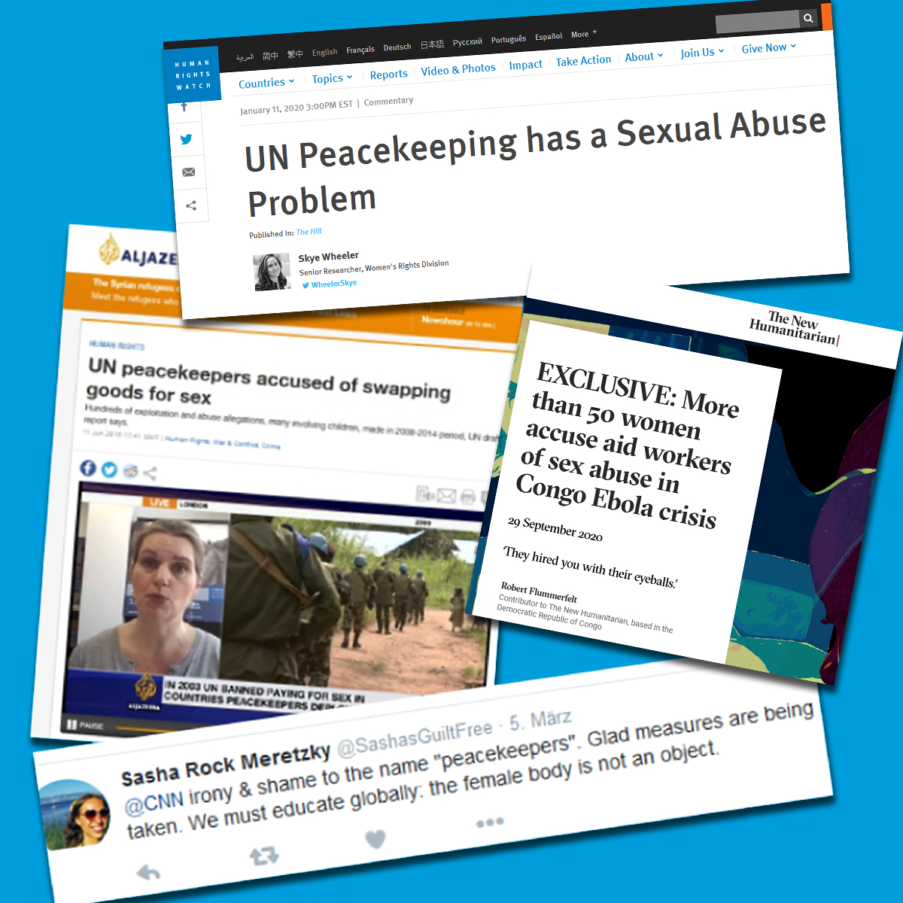
Sexual exploitation and abuse damages the work of the UN
Acts of sexual exploitation and abuse by UN personnel damage donor support for the UN and its work.
Acts of sexual exploitation and abuse by uniformed personnel serving under the UN flag damage the reputation of troop- and police-contributing countries overseas.

Slide 68
Summary
What you have covered in lesson 2
Sexual exploitation and abuse causes physical, emotional, psychological and social harm to victims. A child born as a result of sexual exploitation and abuse by UN personnel may face life-long disadvantage and discrimination.
UN personnel who commit sexual exploitation and abuse will see their professional and personal life suffer, they may be prosecuted and their safety and health may be at risk.
Acts of sexual exploitation and abuse damage the image and credibility of the UN, which in turn undermines the ability of the UN to implement its mandate.

Slide 69
LESSON 3. OBLIGATIONS OF UN PERSONNEL
What will you learn in lesson 3?
In this lesson, you will learn about:
What are your personal obligations to uphold the UN standards of conduct on sexual exploitation and abuse?
How should you report sexual exploitation and abuse?
Who investigates sexual exploitation and abuse by UN personnel?
How will you find out about the outcome of an investigation?
What help is given to victims?

Slide 70
What are your four key obligations?
All UN personnel have four key obligations.
Firstly, they should be familiar with the UN standards of conduct on sexual exploitation and abuse.
Know the UN standards of conduct on sexual exploitation and abuse.
Training on the UN standards of conduct on sexual exploitation and abuse should be completed at the start of your UN assignment (e.g. within the first two months).
In addition to completing this online training, you should attend all other UN training and briefings offered to you on UN standards of conduct on sexual exploitation and abuse.

Slide 71
What are your four key obligations?
Secondly, they have to comply with the UN standards of conduct on sexual exploitation and abuse and any duty station specific codes of conduct and restrictions.
Comply with UN standards of conduct and any duty station specific codes of conduct and restrictions.
For example, check on any curfews and restrictions in your duty station. Missions-specific restrictions include, for example, a prohibition on UN personnel visiting off-limits premises where prostitution and/or human trafficking is suspected or known to occur, or a non-fraternization policy for contingent personnel.
Inadequate provision of welfare and recreation facilities, a high workload, and prolonged periods of work without breaks can all lead to high levels of stress. High stress levels can result in poor judgement and harmful behavior such as excessive drinking, drug, abuse and unsafe sex.
In UN duty stations, there have been cases of UN personnel buying sex from local women after drinking heavily.
UN personnel can also abide by the UN standards of conduct by taking actions in their daily life to reduce stress and keep a healthy work-life balance. Examples of actions to take in your daily life to reduce stress could include: keeping in touch with family and friends, engaging in hobbies and sports, and taking your holidays, rest and recuperation (R&R) breaks and/or leave.

Slide 72
What are your four key obligations?
Thirdly
They have to report sexual exploitation and abuse by UN personnel.
Fourthly
They have to cooperate with investigations into sexual exploitation and abuse by UN personnel, by providing the requested information, documentation and evidence.

Slide 73

What actions can you take in your daily life to comply with the UN standards of conduct?
Select the different characters to read examples of actions that they took in their daily lives to comply with the UN standards of conduct on sexual exploitation and abuse.
Meet up with friends
When I feel lonely, I call up my friends and invite them out. But I make sure to stay out of places that are off-limits to UN personnel and to get back before curfew.
Pursue hobbies and sports
When I get too stressed, I do stupid things that I regret later. I keep my stress levels under control through hobbies and sports.
Call your family and friends regularly
I am deployed with the UN to a non-family duty station. I knew I would feel lonely without my family and friends around me. So, before I left, we agreed to call each other regularly and to meet when I am on leave.
Make attending UN trainings and briefings a priority
There was a lot to do when I started my new job at the UN, but I made sure to prioritize attending all UN trainings and briefings on UN standards of conduct on sexual exploitation and abuse.

Slide 74
Reporting
الإبلاغ
What and when should I report?
I mentioned earlier that all UN personnel have an obligation to report sexual exploitation and abuse. Let us see what this means in practice.

Slide 75
Reporting
What should you report?
Report to the UN any suspicions, concerns, rumours or complaints that UN personnel have committed sexual exploitation and abuse.
Sometimes you will only be able to report a general suspicion. However, if possible, be specific and report:
WHO was involved.
WHAT happened.
WHERE did it happen.
WHEN did it happen.

Slide 76
Reporting
الإبلاغ
Should you report allegations immediately to the UN?
Yes!
1. Do not wait. Report allegations of sexual exploitation and abuse by UN personnel immediately to the UN.
2. Do not try to find out if the allegation is true before reporting it to the UN. That is the job of an investigation.

Slide 77
Reporting channels
الإبلاغ
Report sexual exploitation and abuse to UN management or through the UN chain of command. Reports can also be made directly to the UN Office of Internal Oversight Services (OIOS) or Conduct and Discipline Focal Point (CDFP)/Conduct and Discipline Team (CDT).
Complaints to OIOS can be emailed to: oioshotline@un.org. For more information visit OIOS website. https://oios.un.org/report-wrongdoing
More information on how to report can be found here.
https://www.un.org/preventing-sexual-exploitation-and-abuse/content/how-report

Slide 78
Reporting channels
UN personnel must report allegations of sexual exploitation and abuse to:
Head of Mission.
Conduct and discipline teams or conduct and discipline focal points (for all personnel).
The head of the civilian component or other line managers (for civilian personnel).
The head of the police component or another person in the chain of command (for police and corrections personnel).
The head of the military component or another person in the chain of command (for military personnel).
The UN Office of Internal Oversight Services (OIOS) (for all personnel).

Slide 79
Reporting channels
In UN field missions, it is highly recommended to report allegations to:
In UN field missions, it is highly recommended to report allegations of sexual exploitation and abuse to conduct and discipline teams or conduct and discipline focal points, as they have a formal role in advising the Head of Mission on all conduct and discipline issues and following up on allegations.
Do not report allegations of sexual exploitation and abuse by UN personnel to the UN Ethics Office, the UN Ombudsman and Mediation Services, or the UN Department of Safety and Security (UN DSS) as they have no formal role in receiving allegations of sexual exploitation and abuse by UN personnel, other than relaying the allegation to the relevant UN entity for action. Reporting allegations of sexual exploitation and abuse to these offices could delay handling of the allegations.
The UN Office of Internal Oversight Services (OIOS) is an independent body in charge of investigating allegations of misconduct by UN personnel.

Slide 80
Report in good faith
What else can you tell us about reporting allegations of sexual exploitation and abuse?

Slide 81
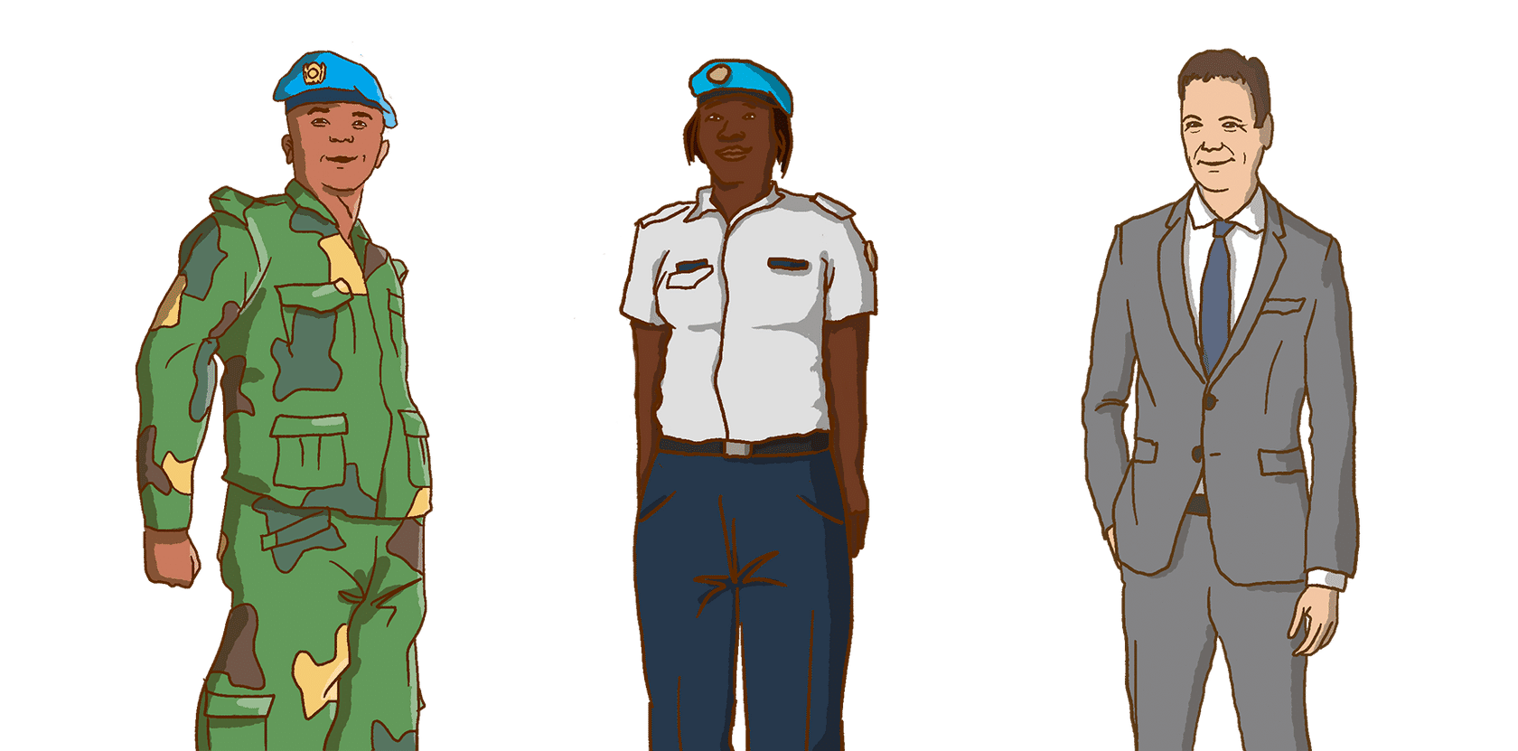
Report in good faith
Good faith
Reports should be made in good faith. If the allegation later proves to be untrue, you will not face repercussions if you reported in good faith.
False, malicious complaints made in bad faith:
Persons who make a malicious complaint of sexual exploitation and abuse that they know to be false, are themselves violating UN standards of conduct and guilty of serious misconduct.
UN staff members can be dismissed if they report a suspicion of sexual exploitation and abuse by UN personnel in bad faith, i.e. if they report a suspicion that they know to be false.

Slide 82
Report in good faith
Anonymous reports
Reports can be made anonymously, or not.
This means that you don’t have to give your name when reporting a suspicion of sexual exploitation and abuse. Anonymous complaints will be treated just as seriously.
However, if you decide to report anonymously, do provide sufficient detail to allow for independent corroboration of the allegation. Otherwise, it may not be possible to investigate.
UN staff are protected against retaliation for reporting misconduct and for cooperating with duly authorized audits or investigations.
Click to read about whistleblower protection for UN staff.

Slide 83
Deciding to report sexual exploitation and abuse
When you report a suspicion of sexual exploitation and abuse you may feel anxious or even scared. This is a normal reaction. Let us look at the following scenario where Oscar has to decide whether to report a suspicion of sexual exploitation and abuse by UN personnel.

Slide 84
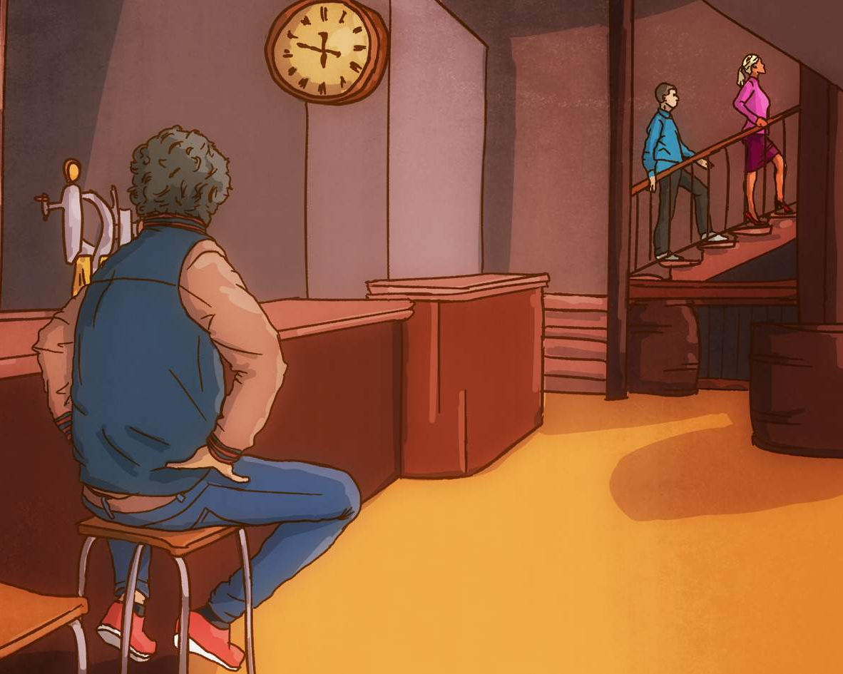
Deciding to report sexual exploitation and abuse
At the end of the workday, UN personnel are enjoying a drink in a bar. Oscar sees Jacques go to one of the rooms upstairs with a woman.

Slide 85
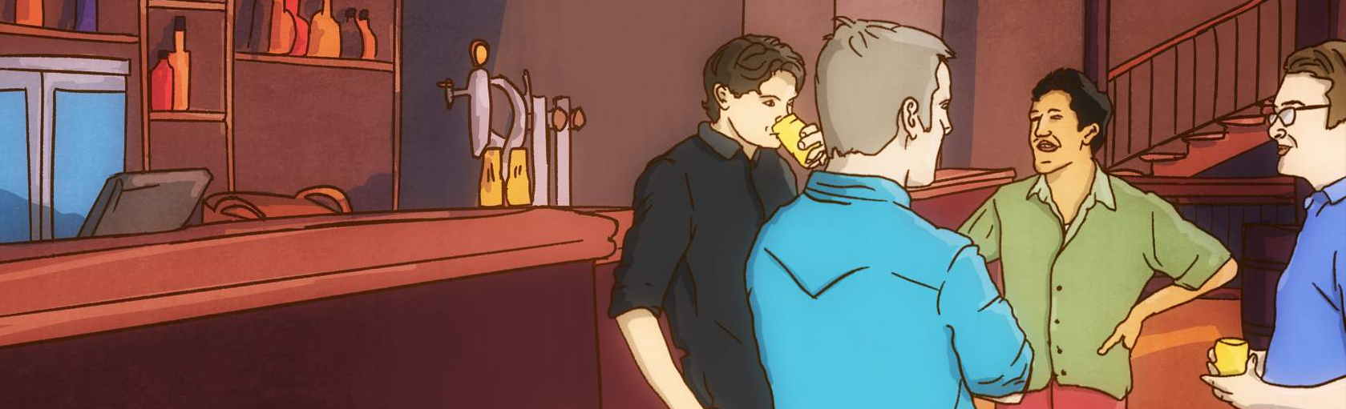
Deciding to report sexual exploitation and abuse
Later on, Jacques comes out of the room with the woman. Jacques goes back to his group of UN friends at the bar.

Slide 86
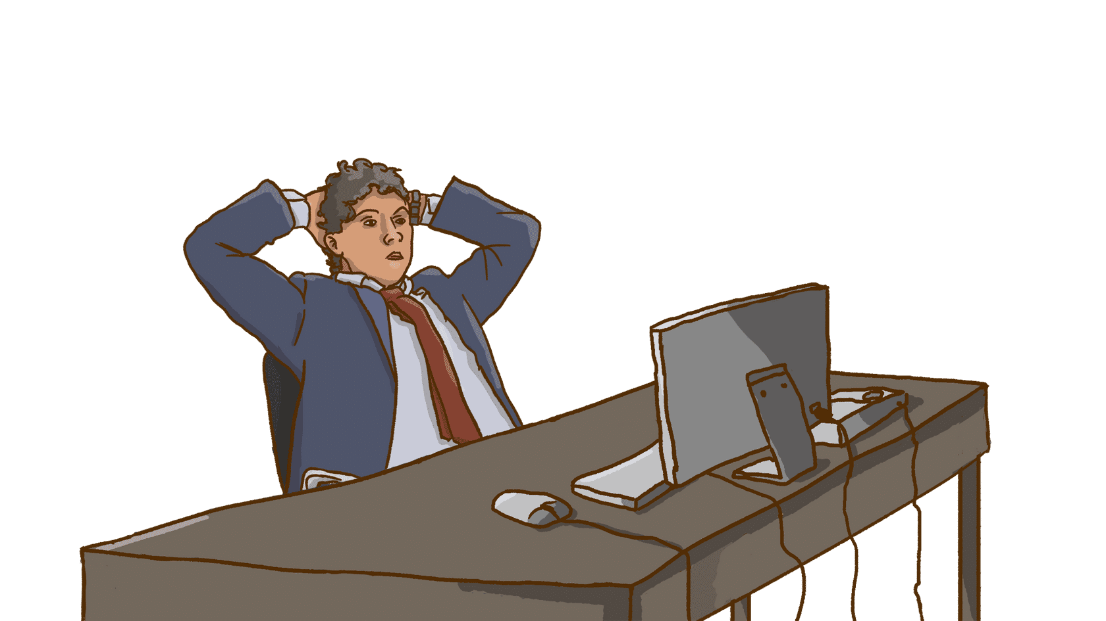
Deciding to report sexual exploitation and abuse
Oscar is back in the office the next day. He can’t stop thinking about what he saw yesterday in the bar.

Slide 87
What do you think?
Should Oscar wait until he has more evidence that sexual exploitation and abuse has occurred before reporting it?
Yes.
No.
Oscar has decided to report his suspicion that sexual exploitation and abuse may have occurred. Can he make an anonymous complaint?
Yes.
No.

Slide 88
What do you think?
Oscar reported his suspicion that sexual exploitation and abuse may have occurred in good faith. A subsequent investigation concludes that sexual exploitation and abuse did not occur. Has Oscar violated UN standards of conduct?
Yes.
No.

Slide 89

Who investigates sexual exploitation and abuse by UN personnel?
So, what happens after an allegation of sexual exploitation and abuse by UN personnel is reported to the UN? Is an investigation launched?

Slide 90
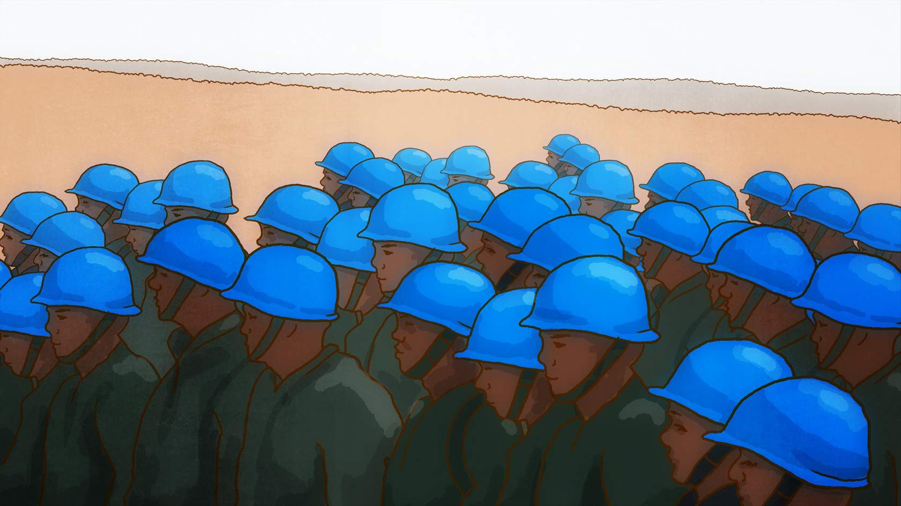
Who investigates sexual exploitation and abuse by UN personnel?
Malik´s answer
Yes, an investigation must be conducted immediately. UN troop-contributing countries are responsible for investigating members of their national military contingents.
Example:
Troop-contributing countries are expected to complete an investigation into an allegation of sexual exploitation and abuse within six months, save in exceptional circumstances. If a troop-contributing country is unable or unwilling to launch its own investigation, then the UN can investigate instead. If a troop- or police-contributing country has not taken appropriate steps to investigate allegations of sexual exploitation and abuse involving its personnel, the UN may replace all of that country’s military units and/or formed police units with those from a different country.

Slide 91
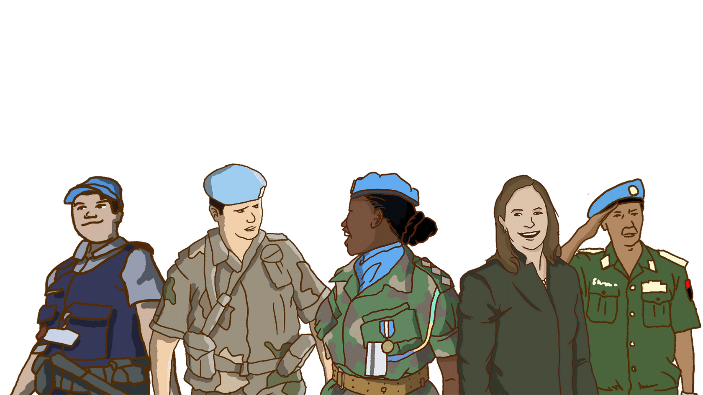
Who investigates sexual exploitation and abuse by UN personnel?
The UN is responsible for investigating all other UN personnel.
Example:
For example, the UN conducts investigations into allegations of sexual exploitation and abuse by UN staff, UN Volunteers, UN Police Officers (UNPOL), members of UN formed police units, UN corrections officers and UN military liaison officers

Slide 92

Who investigates sexual exploitation and abuse by UN personnel?
Fatou´s answer
Remember, do cooperate with investigations into sexual exploitation and abuse by UN personnel.
Example:
For example, provide any information, documentation and evidence that could assist the investigation, and make yourself and your subordinates available to be interviewed by investigators.

Slide 93
Communicating the outcome of investigations
Once the investigation is concluded, the UN communicates the outcome of the investigation to the general public.

Slide 94
Does the public have access to these reports?
Yes. The UN Secretary-General produces an annual report on sexual exploitation and abuse by UN personnel that includes statistics and information on the outcome of investigations and actions taken by the UN and its Member States. This is a public document and can be found here.
The data related to the allegations can be also found here.
If an allegation of sexual exploitation and abuse turns out to be false, the UN also communicates this information in order to repair the reputation of the UN and its Member States.

Slide 95
What help is given to victims?
Immediate assistance to victims
Once an allegation of sexual exploitation and abuse is made against UN personnel, the UN has to make sure that alleged victims are referred to any immediate help they require and are protected from further harm.

Slide 96
What help is given to victims?
At this stage, it is not known whether the allegation is true or not, but the UN still has an obligation to refer alleged victims to any immediate help they require and to take immediate steps to prevent any further harm. For example, the alleged victim may need urgent medical help, psychosocial support, emergency shelter, food or physical protection from retaliation for speaking out.
It is to be noted that reports of allegations can also be made by the local population, whether a victim, a witness, or someone acting on behalf of the victim.
There are several reporting channels available including hotlines, email addresses and community-based networks. Since 2018, Victims’ Rights Advocates and/or Senior Victims’ Rights Officers are in place in the Central African Republic, the Democratic Republic of the Congo, Haiti and South Sudan.
These Advocates are a focal point of victims, on the ground, and they take steps to ensure that a victim-centered, gender- and child-sensitive and non-discriminatory approach is integrated into the United Nations victim support system.

Slide 97
Longer-term assistance to victims
If an investigation concludes that sexual exploitation and abuse did occur, the UN will refer the victim to any longer-term assistance required.
The UN will facilitate access for the victim to longer-term assistance such as returning to school, vocational skills training, or legal aid to pursue criminal proceedings or a child support claim.
Read about the Trust Fund in Support of Victims of Sexual Exploitation and Abuse here.

Slide 98
Summary
What you have covered in lesson 3:
Know what the UN standards of conduct are on sexual exploitation and abuse.
Comply with the UN standards of conduct on sexual exploitation and abuse and any duty station specific codes of conduct and restrictions.
Report to the UN any suspicions, concerns, rumours or complaints that UN personnel have committed sexual exploitation and abuse.
Cooperate with investigations into sexual exploitation and abuse by UN personnel.
Tips
Do not wait. Report allegations of sexual exploitation and abuse by UN personnel immediately to the UN.
Reports can be made anonymously or not.

Slide 99
LESSON 4. MANAGERIAL AND COMMAND RESPONSIBILITIES
What will you learn in lesson 4?
In this lesson, you will learn about:
Describe the specific responsibilities of managers and commanders in addressing sexual exploitation and abuse by UN personnel.
Identify which actions to take to prevent sexual exploitation and abuse by subordinates.
Describe how to handle an allegation of sexual exploitation and abuse involving subordinates.

Slide 100
What are your specific responsibilities?
Notes:
https://player.vimeo.com/video/697425858

Slide 101

Managerial and command responsibilities
Hi again! Did you see the video? Then you might have seen that managers and commanders have specific responsibilities, including the obligation to take steps to prevent sexual exploitation and abuse by their subordinates. Can we meet in my office to discuss that in more detail?

Slide 102
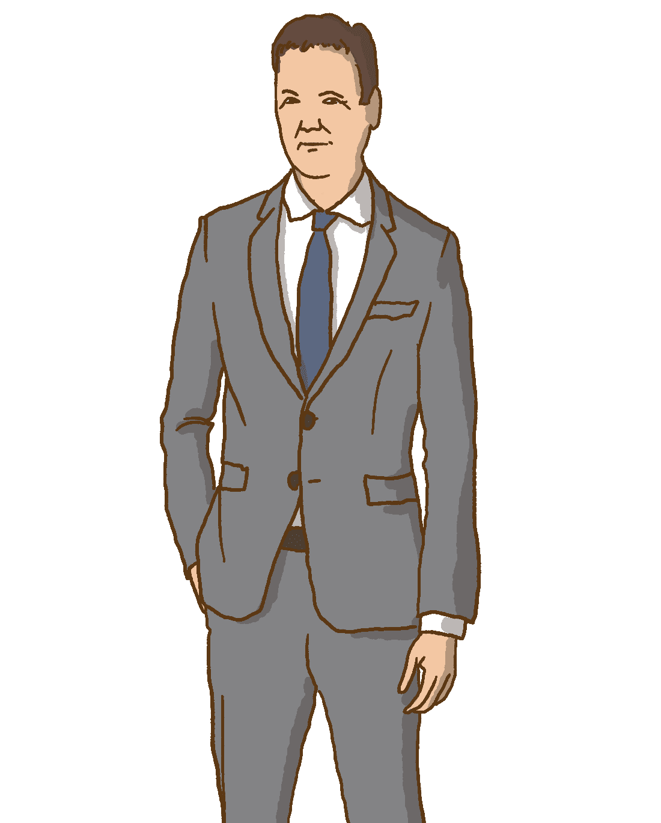
Take steps to prevent sexual exploitation and abuse
Can you explain what it means that managers and commanders must take steps to prevent sexual exploitation and abuse by their subordinates?

Slide 103
Take steps to prevent sexual exploitation and abuse
Malik
Yes, it means that it is their job to ensure that their subordinates know the UN standards of conduct on sexual exploitation and abuse.
It means that managers and commanders must ensure that their subordinates comply with the UN standards of conduct and any duty station specific codes of conduct and restrictions.

Slide 104
Take steps to prevent sexual exploitation and abuse
Fatou
Managers and commanders must also identify potential risks of sexual exploitation and abuse by their subordinates and address those risks. Read about the Risk Management Toolkit here.

Slide 105
Watch out for warning signs and potential risks
Fatou told us that managers and commanders are responsible for identifying warning signs and potential risks of sexual exploitation and abuse by subordinates.
Let us take a minute to think about what these warning signs and potential risks might look like….

Slide 106
What are warning signs and potential risks?
Before we continue, take a moment to think about this:
What could be warning signs and potential risks of sexual exploitation and abuse by your subordinates?

Slide 107

Violations of UN rules and standards of conduct
Curfew violations.
UN personnel seen in premises that are off-limits to UN personnel where prostitution and/or human trafficking for sexual exploitation is known or suspected to occur.
UN vehicles repeatedly seen parked close to premises where prostitution is known or suspected to occur.
UN vehicles carrying unauthorized passengers where there is no obvious work-related reason for doing so (e.g. to go to a meeting).
UN equipment (phones, tablets, computers) being used to view pornography in violation of UN rules and regulations. Some pornography could involve sexual exploitation and abuse (e.g. pornographic images of children).
Unauthorized absences by contingent members from their UN camp/barracks.
Holes in the perimeter fence of the UN camp/barracks. In UN field missions, there have been cases of contingent members using holes in the perimeter fence to leave their camp at night to visit a brothel, or smuggling in a local woman to have sex in exchange for money.
Weak enforcement of standard operating procedures on controlling entry and exit to UN camp/barracks. For example, children and unauthorized guests being allowed in.
Repeated minor disciplinary infractions, as these may be a warning sign of a culture of impunity where the manager or commander is turning a blind eye and ignoring more serious forms of misconduct such as sexual exploitation and abuse.

Slide 108
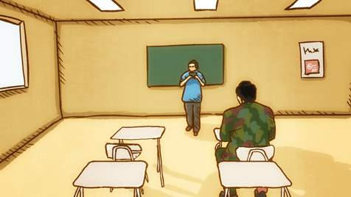
Lack of training
You are in charge of UN personnel who have not yet been trained on the UN standards of conduct on sexual exploitation and abuse. For example, newly recruited UN civilian personnel, troops that have recently been re-hatted as UN troops and newly deployed uniformed personnel who have not received pre-deployment training on UN standards of conduct on sexual exploitation and abuse.

Slide 109
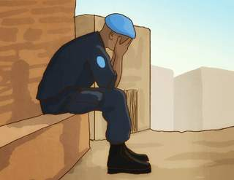
High levels of stress
Inadequate provision of welfare and recreation facilities (such as a gym), a high workload and prolonged periods of work without breaks can all lead to high levels of stress. High stress levels can result in poor judgement and harmful behavior such as excessive drinking, drug abuse and unsafe sex. In UN duty stations, there have been cases of UN personnel buying sex from local women after drinking heavily.

Slide 110
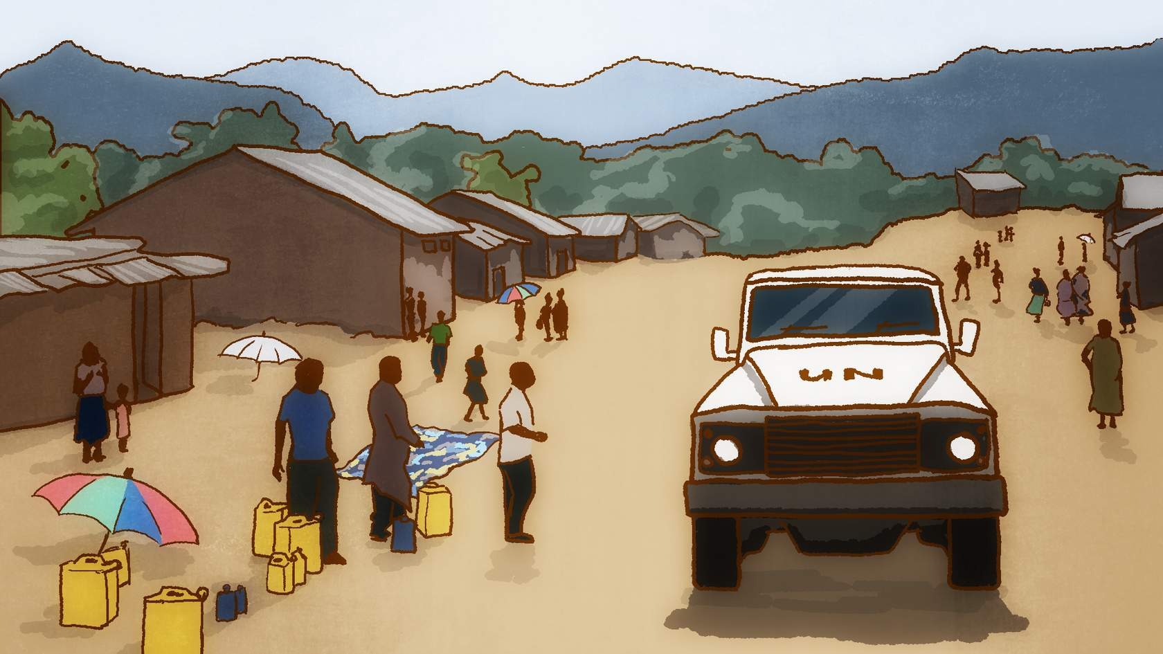
The external environment
The population in the area (local nationals, internally displaced persons (IDPs), refugees) have low awareness of the UN standards of conduct on sexual exploitation and abuse for UN personnel.
The population in the area tolerates or condones certain forms of conduct that are prohibited by the UN (such as exchanging money or gifts for sex).
The population in the area does not know how to report sexual exploitation and abuse by UN personnel.
There are few channels to allow the population in the area to report sexual exploitation and abuse by UN personnel.
UN personnel are housed in a hotel, where the local population has access to.
The UN camp/barracks for uniformed personnel is located close to vulnerable populations (e.g. a camp of internally displaced persons (IDPs) or schools) or close to markets.
UN personnel live in private housing in locations where there is a thriving commercial sex industry..

Slide 111
What actions can you take to prevent sexual exploitation and abuse?
Now that we have reviewed some of the warning signs and potential risks, let us see what specific actions you can take as a manager or commander to prevent sexual exploitation and abuse by your subordinates.

Slide 112
What actions can you take to prevent sexual exploitation and abuse?
As a manager or commander, there is a lot you can do to prevent sexual exploitation and abuse by your subordinates and address some of the warning signs and potential risks.

Slide 113
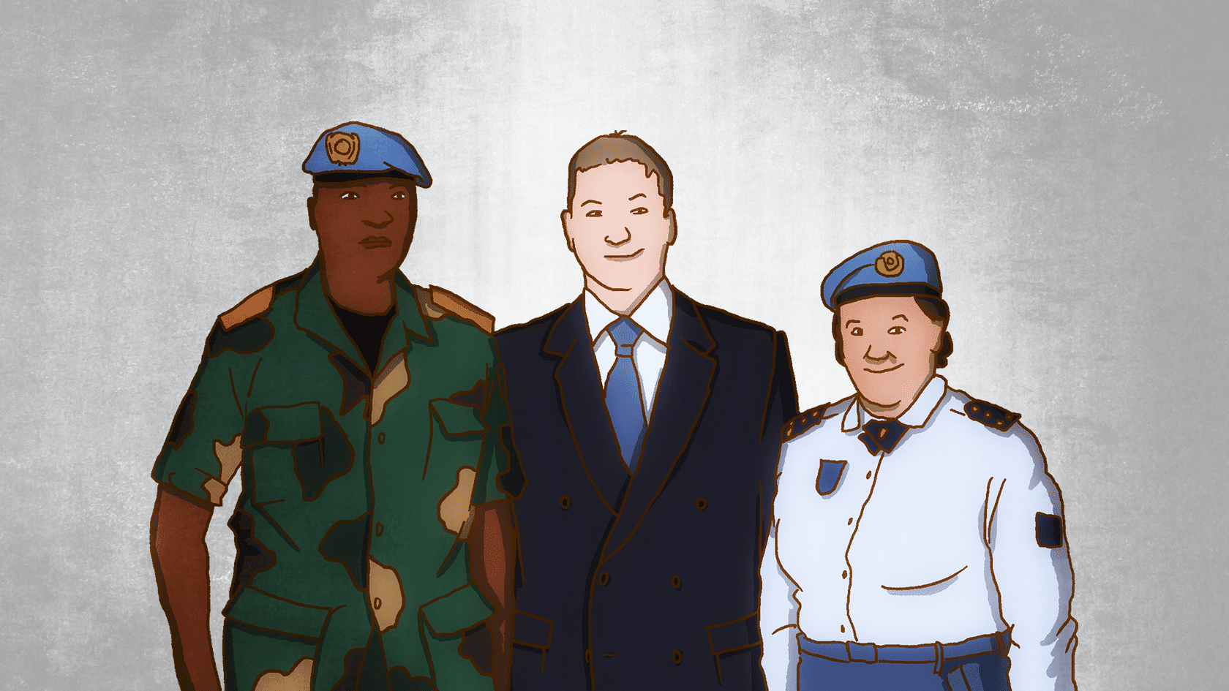
What actions can you take to prevent sexual exploitation and abuse?
Firstly
First of all, you can make sure that your subordinates and others know the UN standards of conduct. Let us look at some specific actions you can take.
Be a role model and lead by example
For example, make sure you complete induction and refresher training sessions on the UN standards of conduct on sexual exploitation and abuse.
Make sure that your own performance workplan includes specific actions you will take to exercise your conduct and discipline functions.
You should also consider hosting a learning event for managers or commanders on prevention of sexual exploitation and abuse.

Slide 114
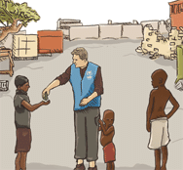
What actions can you take to prevent sexual exploitation and abuse?
Instill pride of purpose
Instill pride of purpose by reminding your subordinates of the UN’s mission in the country, and of specific mandates to protect civilians.

Slide 115
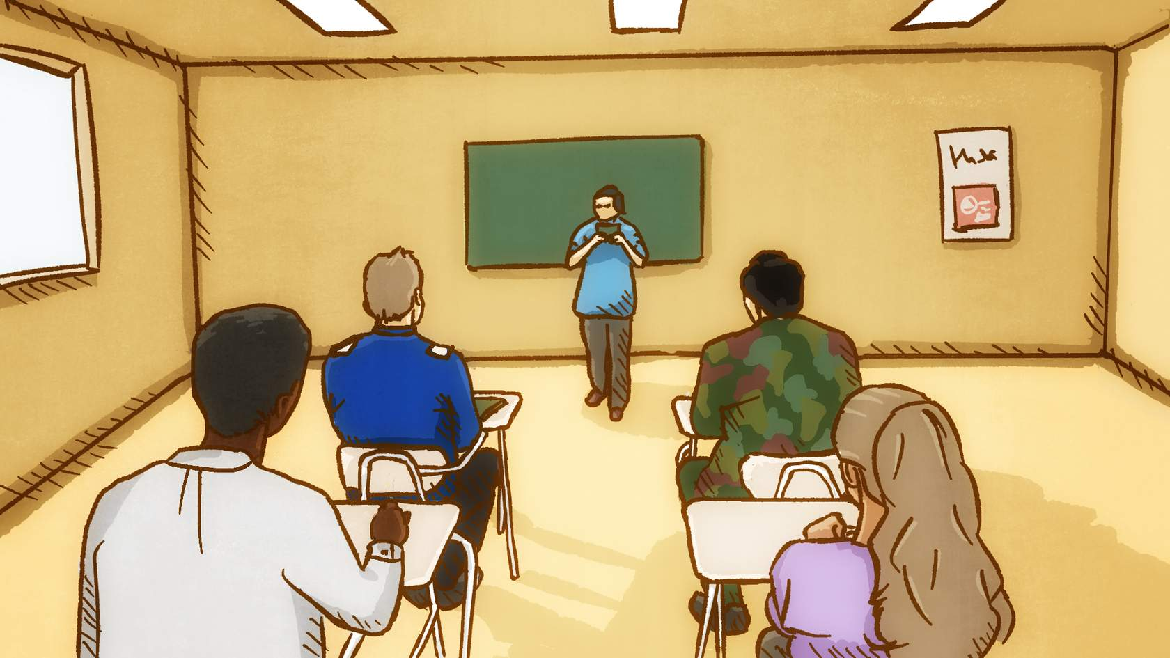
What actions can you take to prevent sexual exploitation and abuse?
Require trainings to be completed without delay
Require your subordinates to complete induction and refresher training sessions on the UN standards of conduct on sexual exploitation and abuse. Make it clear that this is mandatory.
Dedicate some time to allow your subordinates to finish the training.
Make it clear to your subordinates that training on the UN standards of conduct on sexual exploitation and abuse should be completed at the start of their UN assignment (e.g. within the first two months).

Slide 116

What actions can you take to prevent sexual exploitation and abuse?
Include training in workplans
Ensure that your subordinates include the completion of mandatory and other trainings on UN standards of conduct on sexual exploitation and abuse in their workplans.
Use the UN performance appraisal system to review whether your subordinates completed all mandatory and other trainings on sexual exploitation and abuse.

Slide 117
What actions can you take to prevent sexual exploitation and abuse?
Raise awareness
In the workplace, guesthouses and UN camp/barracks, display posters and other awareness-raising materials about UN standards of conduct on sexual exploitation and abuse.
When interacting with the host population, inform them of the UN standards of conduct on sexual exploitation and abuse and how to report instances of abuse.
Managers and commanders are responsible for verifying that reporting mechanisms are in place for their subordinates to report sexual exploitation and abuse by UN personnel. This does not depend on whether the UN location has conduct and discipline teams or conduct and discipline focal points in place.

Slide 118
What actions can you take to prevent sexual exploitation and abuse?
Secondly
Secondly, you can prevent sexual exploitation and abuse by ensuring that your subordinates comply with UN standards of conduct and any duty station specific codes of conduct and restrictions. Let us look as some specific examples.
Set the tone
Make it clear to your subordinates that you will not turn a blind eye and ignore suspicions, concerns, rumours or complaints of sexual exploitation and abuse by UN personnel, and that you will take swift and decisive action if such reports are made to you.

Slide 119
What actions can you take to prevent sexual exploitation and abuse?
Provide welfare and recreation
Provide adequate welfare and recreation facilities for your UN personnel.
Identify measures that you can put in place to reduce work-related stress and promote a healthy work-life balance for your subordinates. For example, ensure that your subordinates take annual leave and rest & recuperation (R&R) breaks, and encourage them to make use of duty station welfare and recreation facilities.
This is a requirement of the Memorandum of Understanding between the UN and troop- and police-contributing countries.

Slide 120
What actions can you take to prevent sexual exploitation and abuse?
Clarify duty station specific restrictions
Inform your subordinates about any duty station-specific restrictions and require their compliance. For example, these could include curfews and lists of premises that are off-limits to UN personnel.
Ensure that your subordinates have read and signed any duty station-specific codes of conduct.
Consider adopting additional disciplinary measures
Consider adopting additional measures to maintain good conduct and discipline among your contingent members while they are off-duty. For example, there could be a requirement for contingent members to only leave the camp in groups, to appear in uniform at all times, a non-fraternization policy, or an alcohol ban.

Slide 121
What actions can you take to prevent sexual exploitation and abuse?
Enforce UN rules on all infractions
What may look like a minor infraction of UN rules and regulations, may be a warning sign of something more serious such as sexual exploitation and abuse. Do not ignore these warning signs. You must:
Strictly enforce regulations to prevent and punish unauthorized absences from UN camps/barracks, as these could be a warning sign of contingent members engaging in sexual exploitation and abuse (e.g. visiting brothels).
Enforce prohibitions on UN vehicles carrying unauthorized passengers.
Enforce prohibitions on misuse of UN equipment (phones, tablets, computers) (e.g. to view pornography).
Verify reporting mechanisms are in place
Verify that reporting mechanisms are in place for your subordinates to report sexual exploitation and abuse by UN personnel.

Slide 122
Take steps to prevent sexual exploitation and abuse
Read more about the official obligations to prevent sexual exploitation and abuse.

Slide 123
What are the official obligations for managers and commanders to prevent sexual exploitation and abuse?
Commanders
What are the official obligations for commanders to prevent sexual exploitation and abuse?
Senior managers have the following duty under the UN Secretary-General’s Bulletin on Special measures for protection from sexual exploitation and sexual abuse (ST/SGB/2003/13):
“4.1 The Head of Department, Office or Mission, as appropriate, shall be responsible for creating and maintaining an environment that prevents sexual exploitation and sexual abuse, and shall take appropriate measures for this purpose…”

Slide 124
What are the official obligations for managers and commanders to prevent sexual exploitation and abuse?
Commanders
What are the official obligations for commanders to prevent sexual exploitation and abuse?
Commanders of national military contingents have the following obligations under the Memorandum of Understanding between the United Nations and troop-contributing countries:
“Article 7 ter Discipline
1. The Government acknowledges that the commander of its national contingent is responsible for the discipline and good order of all members of the contingent while assigned to [United Nations Peacekeeping Mission]. The Government accordingly undertakes to ensure that the Commander of its national contingent is vested with the necessary authority and takes all reasonable measures to maintain discipline and good order among all members of the national contingent to ensure compliance with the United Nations standards of conduct, mission-specific rules and regulations and the obligations towards national and local laws and regulations in accordance with the status-of-forces agreement.”
Commanders of formed police units (FPU) have the following obligations under the Memorandum of Understanding between the United Nations and police-contributing countries:
“Article 7 ter Discipline
7.8 The Government acknowledges that the Commander of the FPU is responsible for the discipline and good order of all members of the unit while assigned to [(acronym)]. The Government accordingly undertakes to ensure that the Commander of the FPU is vested with the necessary authority and takes all reasonable measures to maintain discipline and good order among the members of the FPU and to ensure compliance with United Nations standards of conduct, mission-specific rules and regulations and obligations under national and local laws and regulations in accordance with the [(acronym)] [SOFA/SOMA].”

Slide 125
Reporting allegations to the UN
Great! Now that you know what specific actions you can take to prevent sexual exploitation and abuse by subordinates, let us find out more about what you should do when an allegation is reported to you, and how you can keep information confidential.

Slide 126
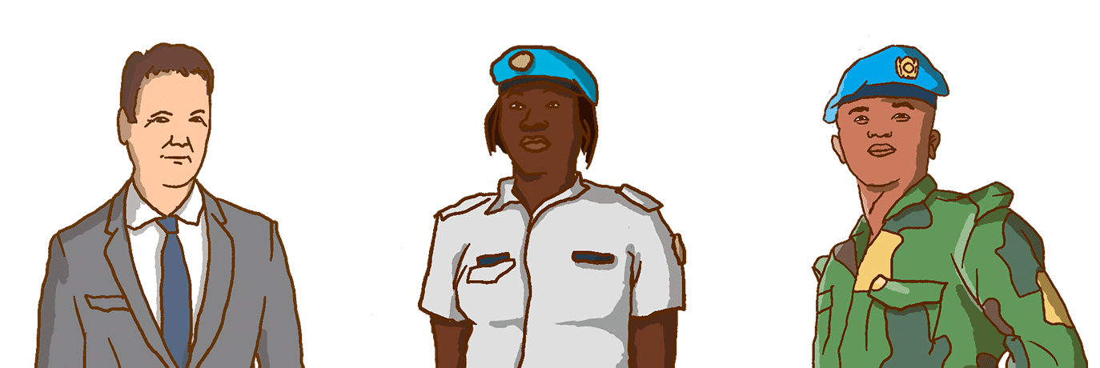
Report allegations immediately to the UN
What would you advise a manager or commander to do when someone reports to them that a UN personnel has engaged in sexual exploitation and abuse?

Slide 127
Report allegations immediately to the UN
Do not wait.
Report allegations of sexual exploitation and abuse by UN personnel immediately to the UN.
For example, you may have a suspicion because of a rumour you have heard, or you may have developed a concern after an unauthorized absence from a UN camp at night, or you may have received a formal complaint by a member of the local population.
If you turn a blind eye and ignore potential, or actual, sexual exploitation and abuse by UN personnel, this will be treated as a breach of duty (for a manager) or failure to exercise effective command and control (for a commander). For managers, failing to report sexual exploitation and abuse may result in administrative sanctions and/or disciplinary proceedings for misconduct. For commanders, failing to report sexual exploitation and abuse will result in repatriation and being barred from future service with the UN, and may result in a finding of misconduct or serious misconduct.

Slide 128
Report allegations immediately to the UN
Do not try to resolve the issue yourself before reporting the allegation to the UN.
Report the allegation immediately to the UN.
For example, do not try to mediate between the alleged perpetrator and the alleged victim(s) and their families or broker a joint solution before reporting the allegation to the UN.

Slide 129
Report allegations immediately to the UN
Do not try to find out if the allegation involving a UN personnel is true before reporting it to the UN.
That is the job of an investigation.
For example, do not try to interview the alleged victim and the alleged perpetrator to find out if the allegation seems to be credible before reporting it to the UN.

Slide 130
Keep it confidential
Managers and commanders need to keep the allegation of sexual exploitation and abuse involving a UN personnel confidential.
Only disclose information to those who require this information in order to exercise their conduct and discipline functions (e.g. a conduct and discipline team, or the head of component) or to investigate the allegation (e.g. the UN Office of Internal Oversight Services (OIOS)).
What do you think?
What information regarding an allegation of sexual exploitation and abuse do you need to keep confidential?
Identity of all involved.
Nationality of all involved.
Nature of the allegation.

Slide 131
Confidentiality and protection
Keep it confidential – Tips
Confidentiality is often breached through idle chatter and gossip. Here are some tips on how to keep information confidential.
Do not gossip yourself about the allegation and ask your subordinates to do the same.
Do not put the the names of the alleged perpetrator and alleged victim(s) in the subject line of an e-mail or any other correspondence.
Do not leave confidential information lying around the printer or photocopier. Always mark code cables or e-mails about allegations of sexual exploitation and abuse as “strictly confidential”.
Do not make public statements on the identity or nationality of those involved in the allegation, unless so authorized.
Do not address or try to resolve the issue yourself by speaking with the alleged perpetrator.

Slide 132
Confidentiality and protection
Protection against retaliation – Advice
Managers and commanders must also protect the person who made the report from retaliation, where this is a concern.
For example, with the agreement of both parties, you could re-assign one of them to other duties to reduce the need for interaction.
If retaliation subsequently happens, managers must report this immediately. If retaliation is found to have occurred, this will be treated as misconduct.
If a commander will not report a case, but a claim is raised by someone else, it puts a bad light on the entire unit and his work.
Read about the Protection against Retaliation here.

Slide 133
How can you support the investigation?
Once an investigation is launched, what can managers and commanders do to support the investigation?

Slide 134
How can you support the investigation?
Well, they must cooperate with the investigation into sexual exploitation and abuse involving a subordinate.
Example
Cooperate with the investigation into sexual exploitation and abuse involving a subordinate:
Failure to cooperate with an authorized investigation relating to sexual exploitation and abuse may be considered as misconduct and handled accordingly.

Slide 135
How can you support the investigation?
And they should also cooperate to investigate paternity claims in cases of sexual exploitation and abuse involving a subordinate.
Example
Cooperate with investigations into paternity claims:
For example, inform your subordinate about the option of providing a DNA swab to prove or disprove a paternity claim made by an alleged victim of sexual exploitation and abuse. The decision by your subordinate to provide DNA is voluntary.

Slide 136
What happens when managers and commanders don’t report?
So, what happens when managers and commanders don't report? Let us hear the stories of a military contingent commander, a UN manager and a police contingent commander who failed to immediately report an allegation of sexual exploitation and abuse by a subordinate to the UN.

Slide 137
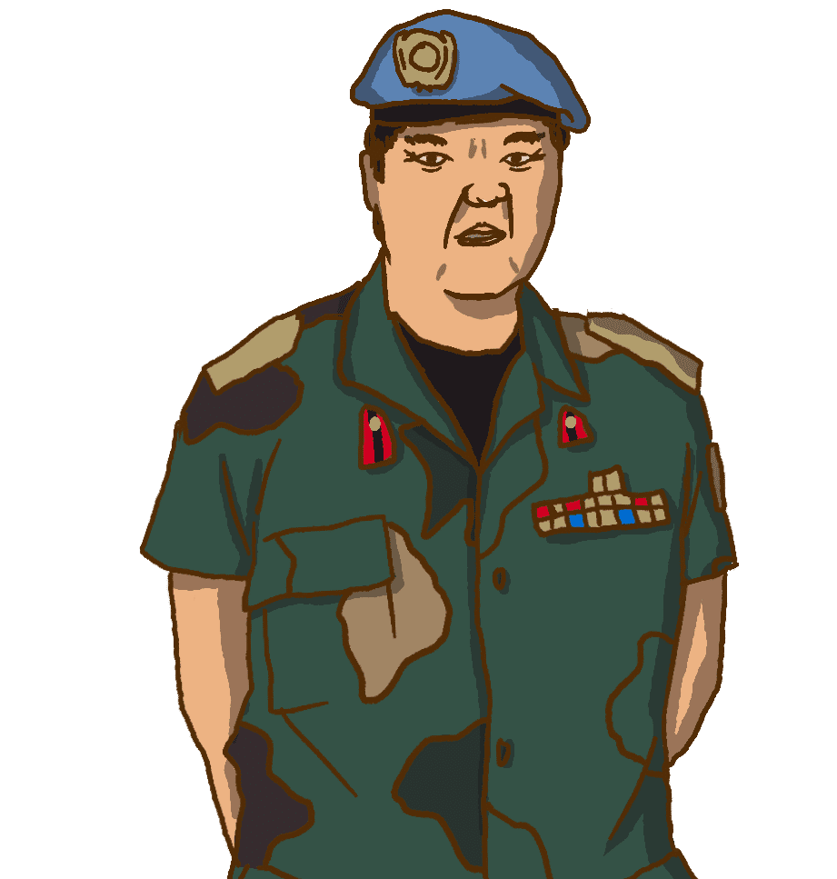
Cheng’s story
Commander of a national military contingent

Slide 138
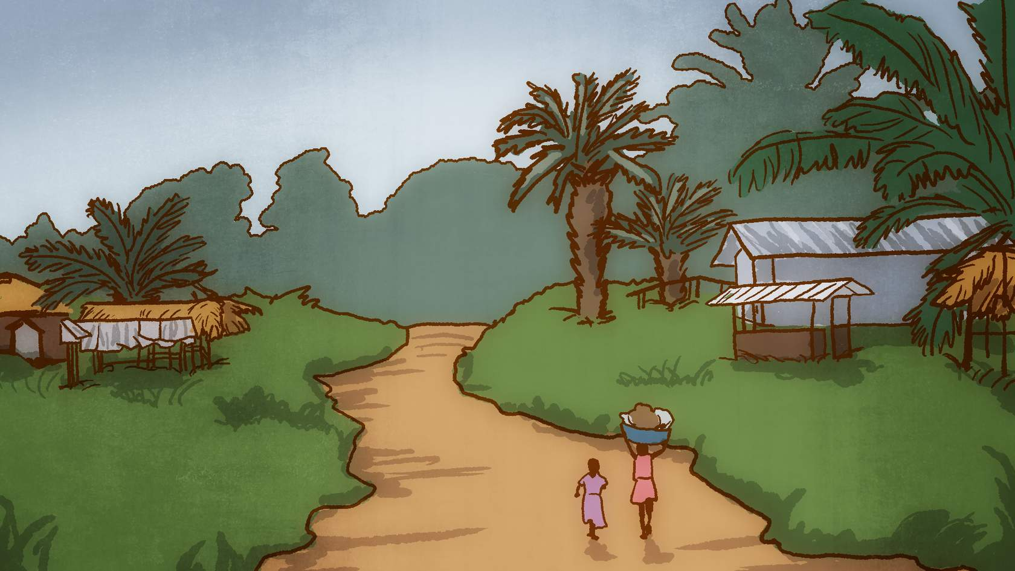
Cheng’s story
Cheng is a commander of a national military contingent. Living conditions are harsh where he is deployed. There are no cinemas, shopping malls, cafés or gyms in town. The contingent has a small gym, but it’s too hot to use most of the time. The internet is too slow to download films or play online computer games. And besides, the internet is not even working most of the time.

Slide 139
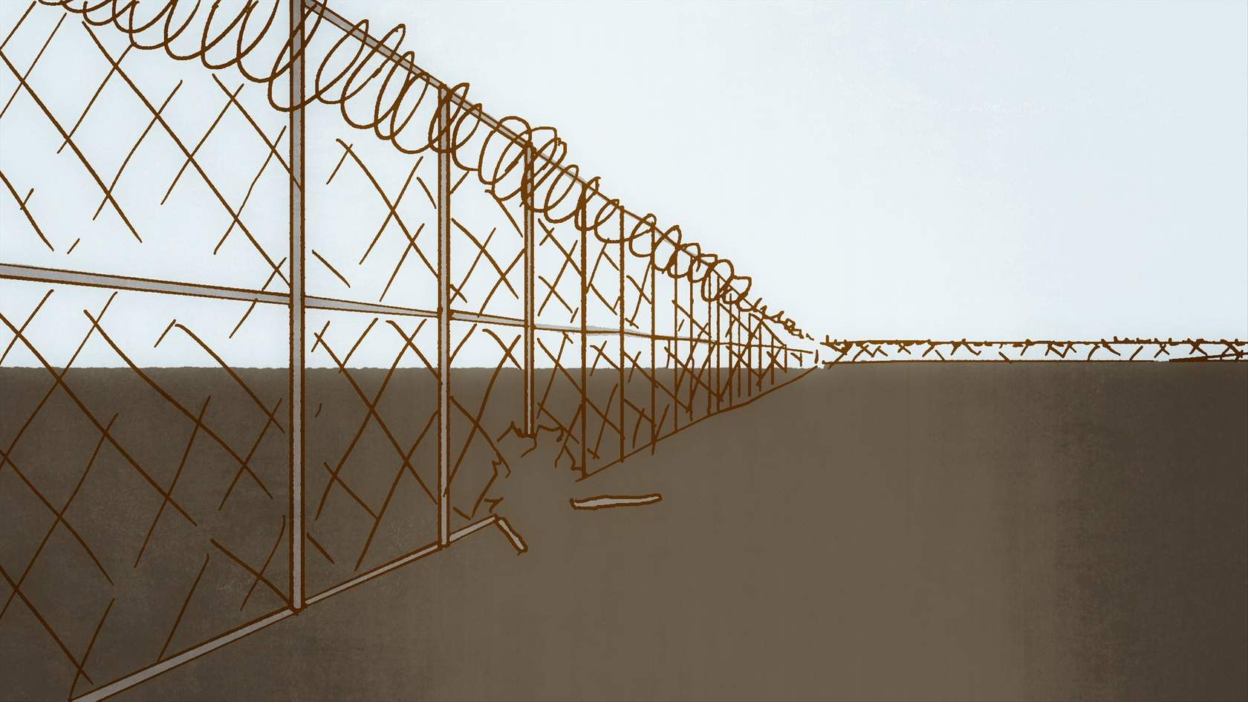
Cheng’s story
Every weekend for the past month, three of his soldiers have been escaping through a hole in the perimeter fence, getting drunk and visiting a local brothel. Cheng suspects that this is happening but ignores it. Conditions are harsh for his soldiers and he doesn’t begrudge them the occasional bit of fun.

Slide 140
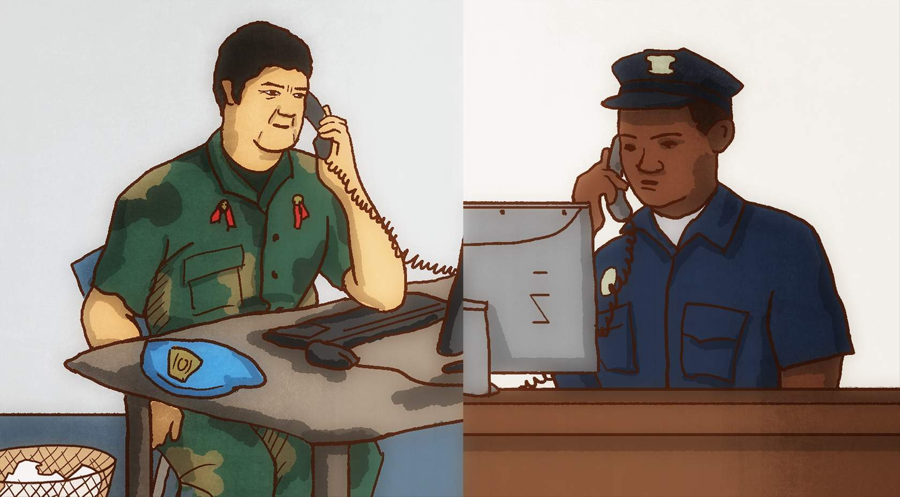
Cheng’s story
Cheng gets a call from the local police chief one night who tells him that his boys are causing trouble in town and to come and get them. It turns out that the three soldiers were visiting a brothel. After they had sex, the prostitutes asked for more money than was originally agreed. The soldiers refused to pay more. It turned ugly and the soldiers started a fight.

Slide 141
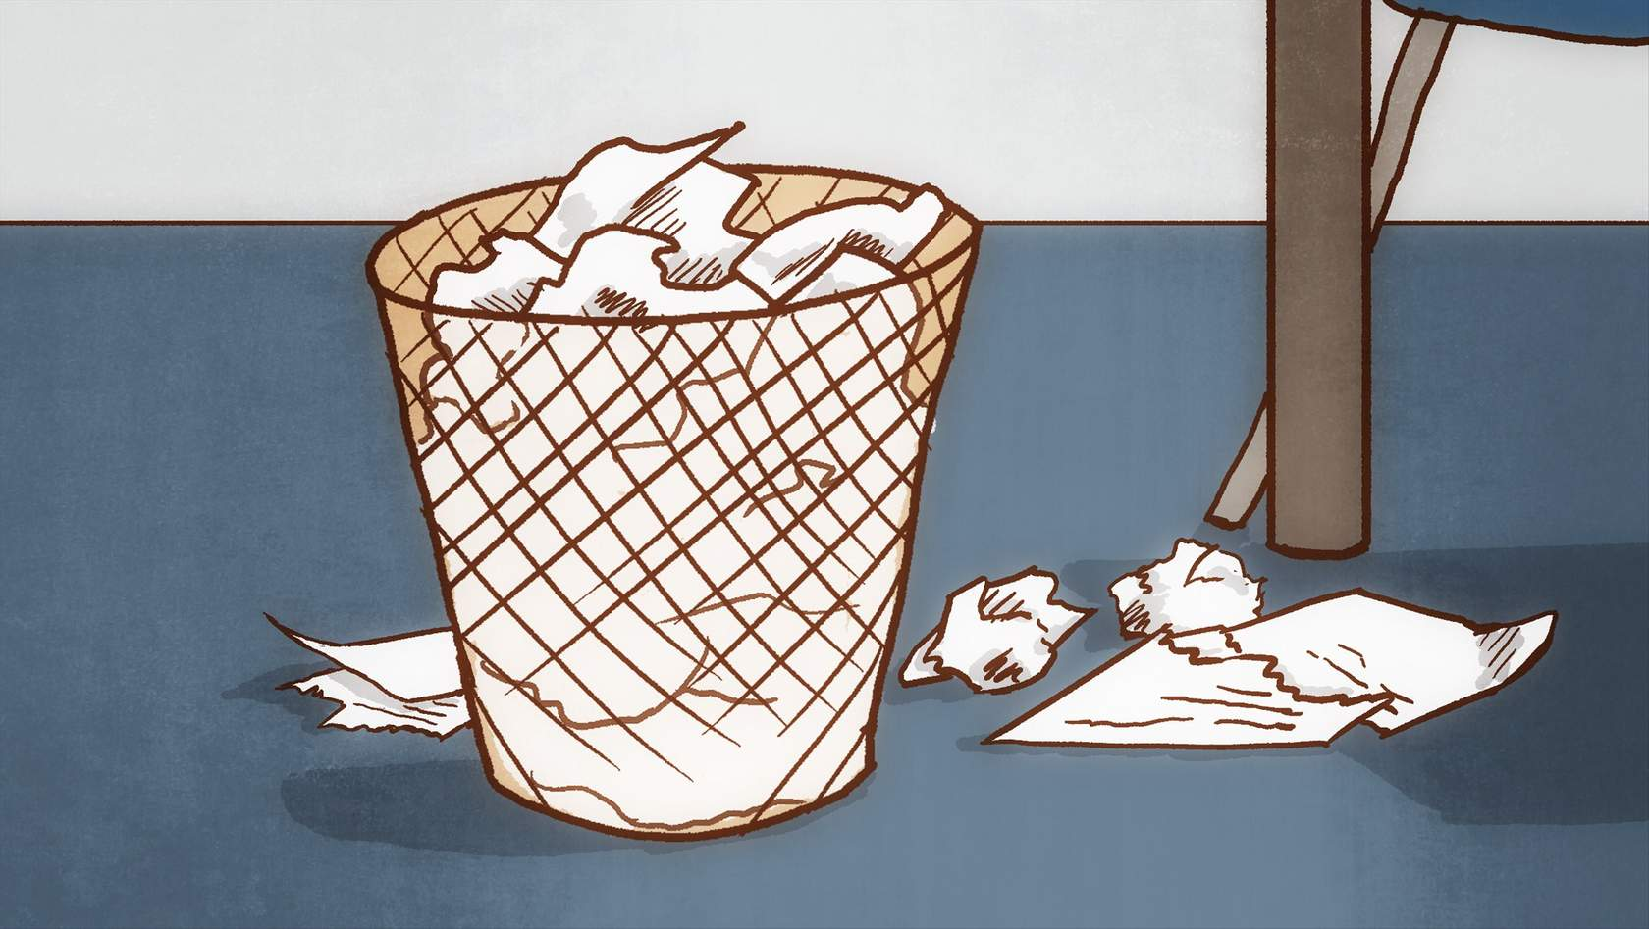
Cheng’s story
Cheng did not report this incident of sexual exploitation and abuse to the UN. He was worried that it would affect his reputation in the UN field mission and damage his career back home. His contingent was soon rotating out, and he hoped that the incident would not come to light until he had left the mission area.

Slide 142

Cheng’s story
It’s a small town where everyone talks. Quite soon the whole story came out into the open.
Cheng was repatriated by the UN to face disciplinary sanctions in his home country. He was barred from serving in the UN in the future. His career with the UN is over and his reputation back home was also damaged.
As a commander, Cheng failed to meet his obligation to maintain good order and discipline among his troops. Cheng was sanctioned for turning a blind eye to what was happening as well as for failing to report sexual exploitation and abuse by his subordinates..

Slide 143
Cheng’s story
Report allegations of sexual exploitation and abuse by your subordinates immediately to the UN. Do not wait.

Slide 144

Gustav´s story
Head of a UN sub-office

Slide 145
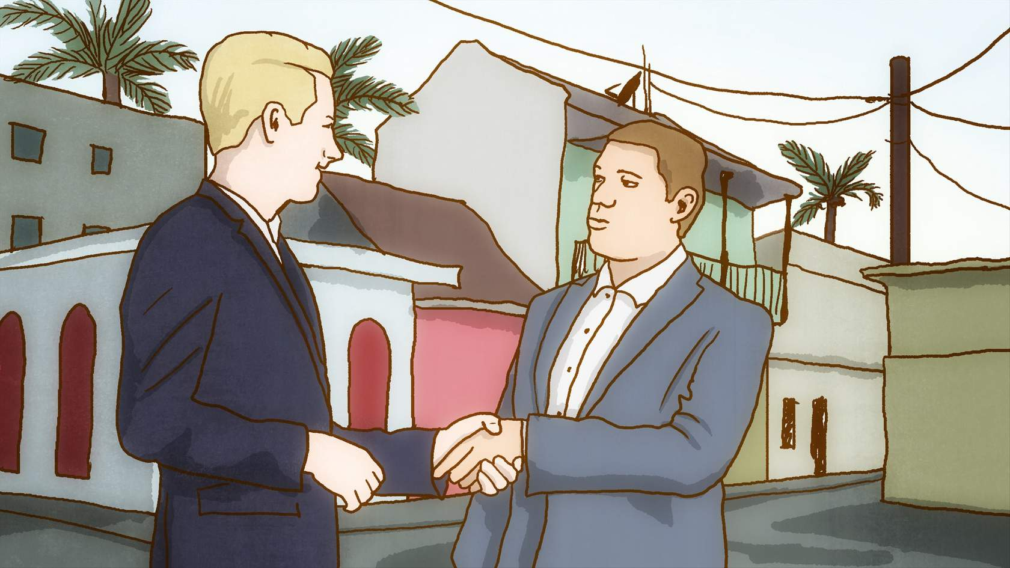
Gustav´s story
Gustav is the head of a UN sub-office in a remote location. Gustav gets on well with all his staff and is good friends with Jonas, a trusted Civil Affairs Officer. Jonas regularly stays in the capital when he is on his rest and recuperation (R&R) break. Each time Jonas is in the capital, he visits a woman called Sylvia. He has an arrangement to pay a specific amount each time he visits her to have sex.

Slide 146

Gustav´s story
Jonas’ assignment with the UN is coming to an end and he will shortly be leaving the country. Sylvia learns of Jonas’ imminent departure and decides to blackmail him. Sylvia threatens to report him to the UN for committing sexual exploitation and abuse unless he pays her more money. Jonas panics and approaches his manager Gustav and asks for help “as a friend”.

Slide 147
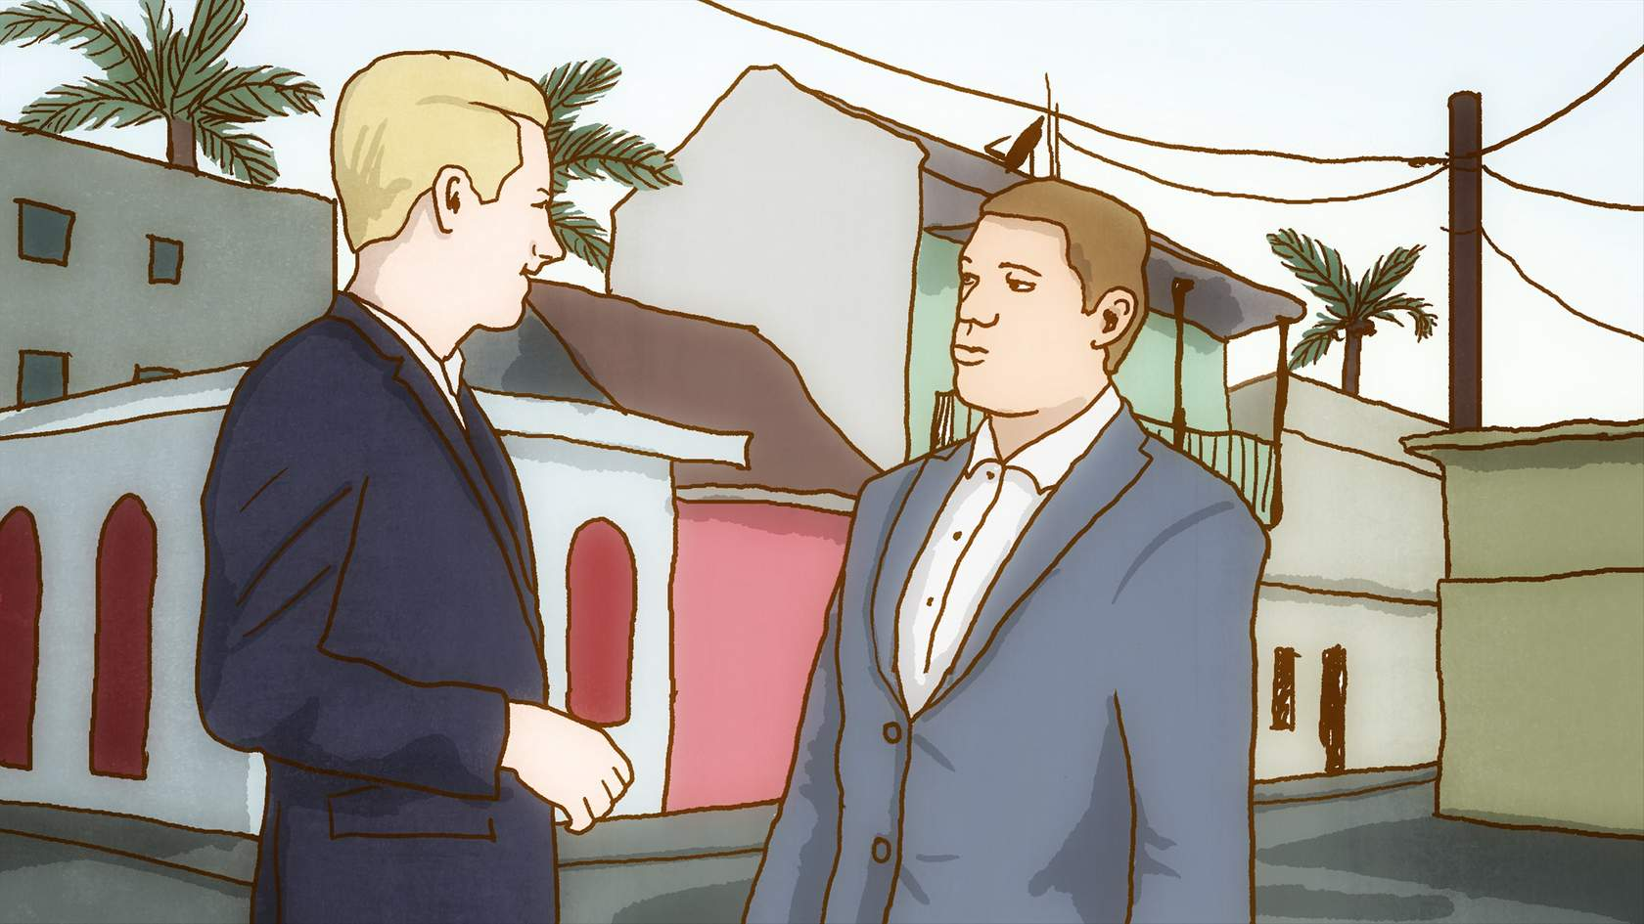
Gustav´s story
Gustav doesn’t want to see his friend Jonas get into trouble and tries to resolve the matter. Gustav advises Jonas to pay Sylvia the bribe. Sylvia takes the money and then asks for more money, threatening again to expose Jonas. At this stage, Gustav realizes that the situation is out of control, and reports the allegation to the UN.

Slide 148
Gustav´s story
Gustav faced disciplinary proceedings for breaching his obligation to report sexual exploitation and abuse and for trying to cover up the incident. As a result, Gustav’s UN career was severely damaged, and his good name and professional reputation ruined.

Slide 149
Gustav´s story
Do not try to resolve the issue yourself before reporting the allegation to the UN.
Report the allegation immediately to the UN.

Slide 150
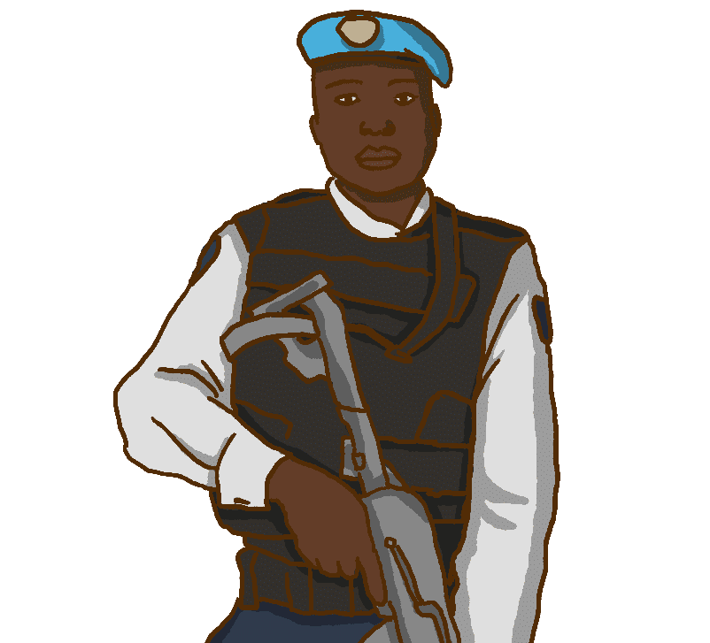
Amo´s story
قصة آمو
Commander of a formed police unit

Slide 151
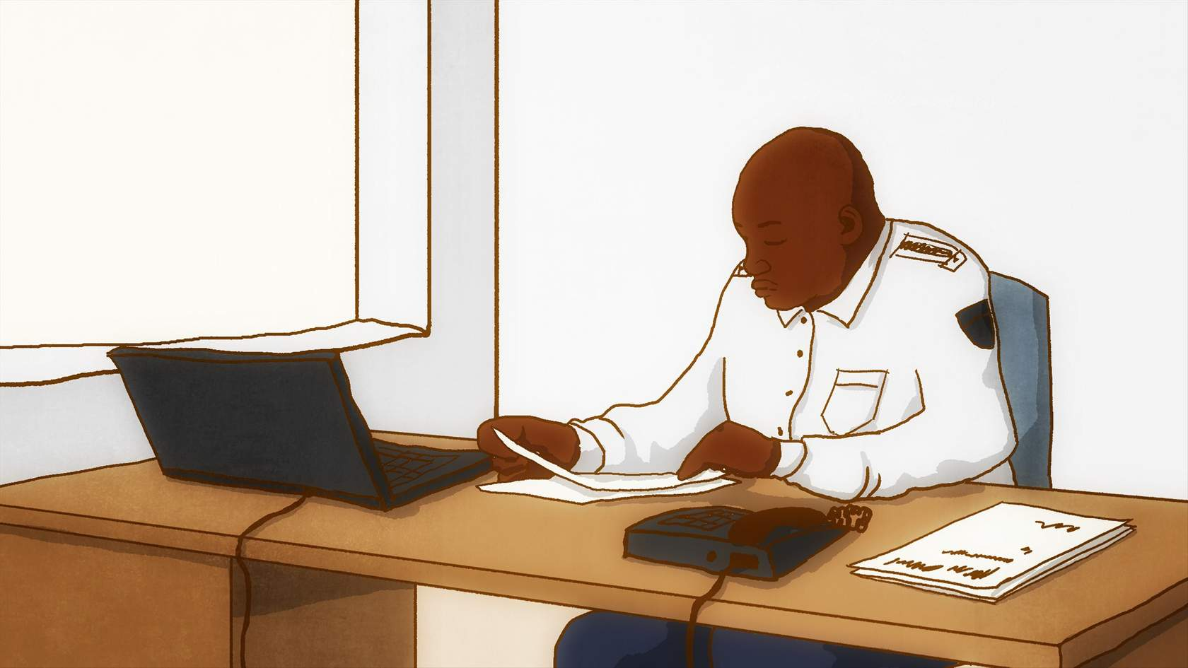
Amo´s story
Amo is a commander of a formed police unit. A local non-governmental organization (NGO) reported to him that one of his police officers sexually assaulted a boy in the local community.

Slide 152
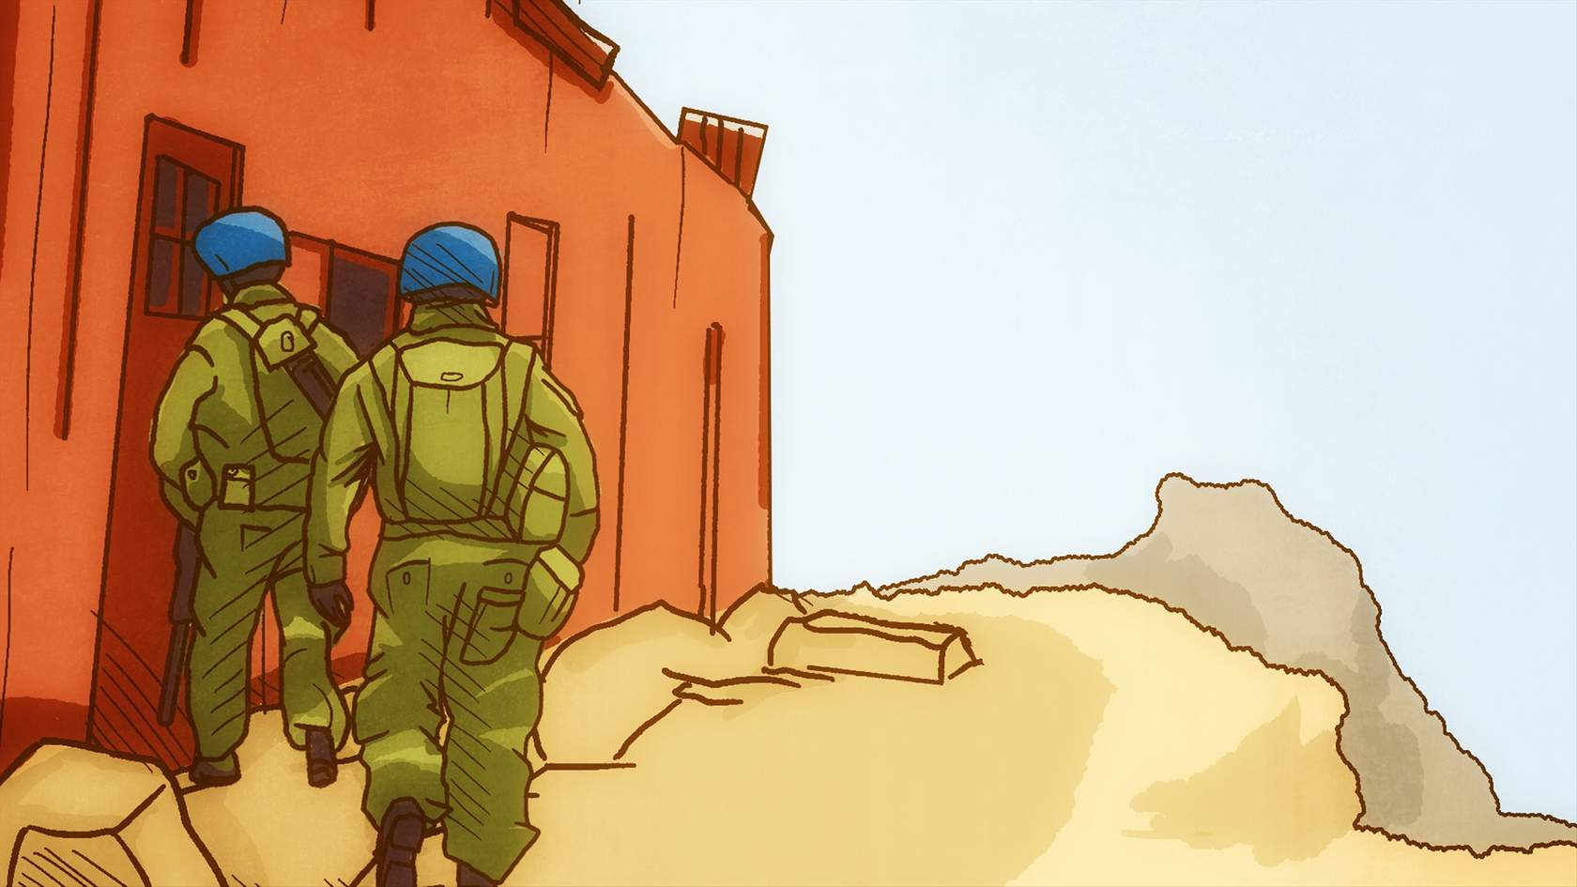
Amo´s story
Amo does not report the allegation to the UN. Instead, two weeks later, he sends out two police officers from his unit to find out if the allegation is credible. The boy is terrified when he sees two armed, male police officers arrive in uniform and refuses to speak. The NGO hears of the incident and is furious. The NGO reports the allegation in writing to the Head of Mission.

Slide 153
Amo´s story
Amo was repatriated by the UN to face disciplinary sanctions for failing to report sexual exploitation and abuse to the UN. He was barred from serving in the UN in the future. His career with the UN is over and his reputation back home was also damaged.
Amo should have informed the UN about the allegation immediately. This would have enabled the boy to be provided with any urgent help he might require (e.g. medical, legal or psychological assistance, safe housing, physical protection from further harm). Amo should not have tried to find out if the allegation seemed credible before reporting it to the UN. That is the job of an investigation.

Slide 154
Amo´s story
Do not try to find out if the allegation involving a subordinate is true before reporting it to the UN. That is the job of an investigation.
These three stories are fictitious examples based on facts from real-life cases. Names, locations and nationalities have been changed to protect identities.

Slide 155
Summary
What you have covered in lesson 4:
You have an obligation to take steps to prevent sexual exploitation and abuse by your subordinates. You must:
  Ensure that your subordinates know the UN standards of conduct on sexual exploitation and abuse.
  Ensure your subordinates comply with the UN standards of conduct and any duty station-specific codes of conduct and restrictions.
  Identify the warning signs of possible sexual exploitation and abuse by your subordinates, and identify and address the potential risk factors which encourage such behaviours.
If you suspect any UN personnel have committed sexual exploitation and abuse, report it immediately to the UN. Do not wait.
Cooperate with investigations and paternity claims relating to sexual exploitation and abuse by your subordinates.

Slide 156


